Slide 1
Introduction to Cyber Security
― To survive in the IT society ―
Introduction, recent topics, case of cyber security

Slide 2
Lecture & Exam
Please bring the computer
  To view lecture materials
  Quiz
１４：５０～１６：１０：Lecture
１６：１０～１６：２０：Quiz
  Performed on Moodle
  Submission deadline of quiz １６：２５
Credits are based on 8 times of quizzes
Final exam is not conducted
The information webpage of lecture
  http://www.cs.kyushu-u.ac.jp/lectures/csp/

Slide 3
Lecture contents
Introduction, Recent Topics, Cases
Secure setting (１)
Secure setting (２)
Learn about the law
Research ethics and information ethics
Copyright
Social science
Encryption

Slide 4

Recent topics related to cyber security
Incident case
  Benesse
  Pension service
Technology and business
  Targeted attack、unavoidable attack
  SOC
Cyber security and society
  Cyber Security Basic Law
  Human resource development
http://ja.wikipedia.org

Slide 5
Incident case
Incident
  Events; (in particular, with the risk of developing serious incident) associated incident, a small incident, conflict
    [Synonym]
      accident : occasion happens unexpectedly;
      event : an important activities or occasions
    From "New English-Japanese dictionary"
Through specific events related to cyber security, know the problem, outline of situation of cyber security。
  Technical curiosity
  Humanities curiosity

Slide 6
Benesse personal information leakage incident
Large-scale personal information leak case of Benesse Corporation (Benesse) discovered on July 9, 2014 .
  Internal crime
  Bringing in external equipment (PC or USB device) to a server room with a database is prohibited.
  The engineer connects the smartphone directly to the database server via USB and extracts the data.
    Surveillance camera in server room
    Database server record
  Engineers are arrested
    Violation of unfair competition prevention law (reproduction of trade secret, disclosure)

Slide 7
Benesse personal information leakage incident
A direct mail using personal information that should have been registered only in Benesse came to be delivered from a company which conducts another correspondence education .A surge inquiries as to whether personal information is leaking or not
Impact (partial)
  Benesse's privacy mark grant will be canceled .
  Two directors who were in the responsible department resigned responsibly
  Publicly announced the number of customer information is 350.4 million . They decided to prepare a cash voucher of 500 yen as compensation for victims of personal information leakage.
    35,040,000 x 500 = Approximately 17.5 billion yen
      Purchase approximately 75,000 roster totaling 600,000 yen
      8 yen / case

Slide 8
Case study of pension service
- Pension management system cyber attack problem -
Personal information leaked from the pension information management system server of the Japan Pension Organization due to external unauthorized access
  Computer virus mail arrived in large quantities from May 8th to May 18th, and at least two officials opened it . On the opening of the first time on May 8th, the official opened an e-mail attachment titled "Opinion on" Review of the welfare pension fund system (draft) " 。
  It was a computer network design that can also access a personal information server with a personal computer that can connect to the Internet
  Targeted mail

Slide 9
Technology and business
Technologies are developed as necessary, and if the technology has marketability, it will develop as business.
If business develops, technology development will accelerate .
Cyber Security
  Technology to attack
    Success as a Making Money
      Further advanced attack technology development
  Surge of defense technology development and business

Slide 10
Target type attack
APT （Advanced Persistent Threat）attack
Use OS and browser vulnerabilities
Led user to access sites to download and execute the software hidden in the contents ,which is using skillful phishing e-mails to exploit vulnerabilities to make external access possible
External software can communicate with it and information leakage is done by external operation.
Specific individuals are aimed at.
Firewalls, anti-viruses, intranets also suffer damage. Countermeasures are only to block vulnerabilities or to overlook phishing mail, but very difficult

Slide 11
Unavoidable threat
Phishing (Mail)
→ Literacy
Water fountain type attack
(Web)
→ Firewall
Defense is not impossible./ Low probability
SNS
Advertisement
Hotel Okura Nau.
Advertisement
Advertisement uses Adobe Flash .
If you open SNS, the flash file is automatically downloaded .（ Unavoidable ）
Advertisements can be made by anyone. Payment is anonymous .
It is cheaper, sure than sending phishing mail with SPAM .
Zero-day attack
Information leakage 、Ransomware
Infected just by opening
Malvertising attack

Slide 12
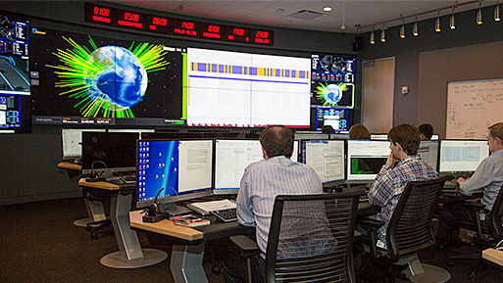
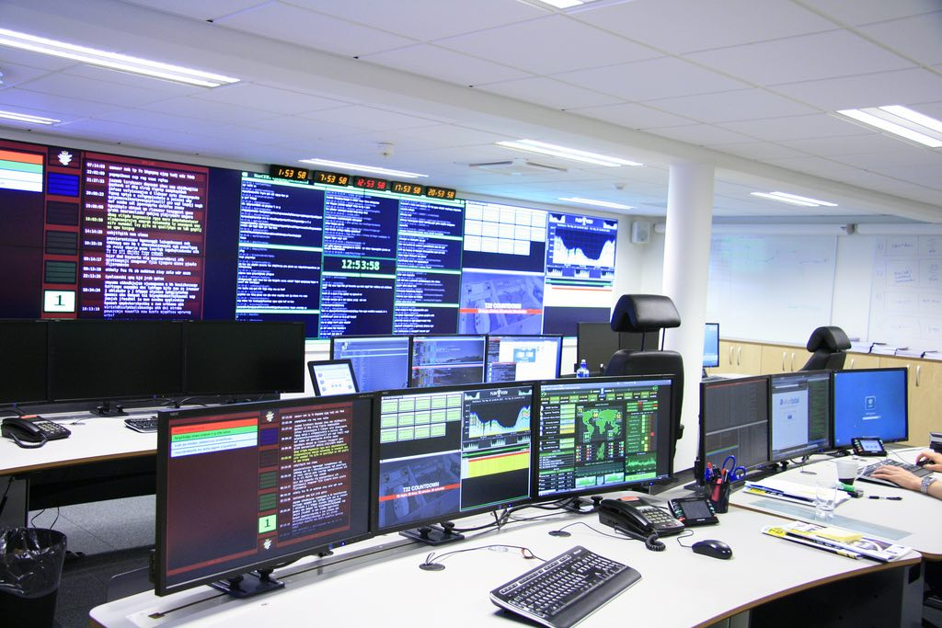
SOC (Security Operation Center)
New Business
Detect organization's attack information
  Collect threat information from all over the world
  Use of pattern information
Discover organization's threat information
  Discover new threats due to abnormal communication.

Slide 13
Cyber security and society
Cybercrime loss amount is 59 trillion yen annually worldwide, Heisei 25
  Necessity to respond at the national level
    Law maintenance
      Basic Cyber Security Act (Heisei 26 years)
      Article: Responsibilities of universities and other educational research institutes
        Secure voluntary cyber security of own organization
        Training personnel related to cyber security
        Research on cyber security
        Promotion of its results and cooperation with national and local governments
    Promotion of technology development
    Education

Slide 14
Basic Cyber Security Act
(Approved on November 6, 2014)
Law stipulating the responsibilities of the government concerning cyber attack countermeasures
Article 8 Responsibilities of Education and Research Organizations Article 8 The university and other education and research institutions shall be responsible for ensuring cyber security voluntarily and actively in accordance with the basic philosophy, training human resources related to cyber security and research on cyber security and its results We will endeavor to disseminate and endeavor to cooperate with measures concerning cyber security implemented by national or local governments.
Article 9 Citizens shall strive to deepen their interest and understanding of the importance of cyber security and pay attention necessary for securing cyber security, pursuant to the basic philosophy.
Full bill
  http://www.shugiin.go.jp/internet/itdb_gian.nsf/html/gian/honbun/houan/g18601035.htm
Notes:
Law stipulating the responsibilities of the country concerning cyber attack countermeasures.
Countermeasures concerning cyber security made it clear that it is the responsibility of the government.
Establish "cyber security strategy headquarters" in the Cabinet

Slide 15
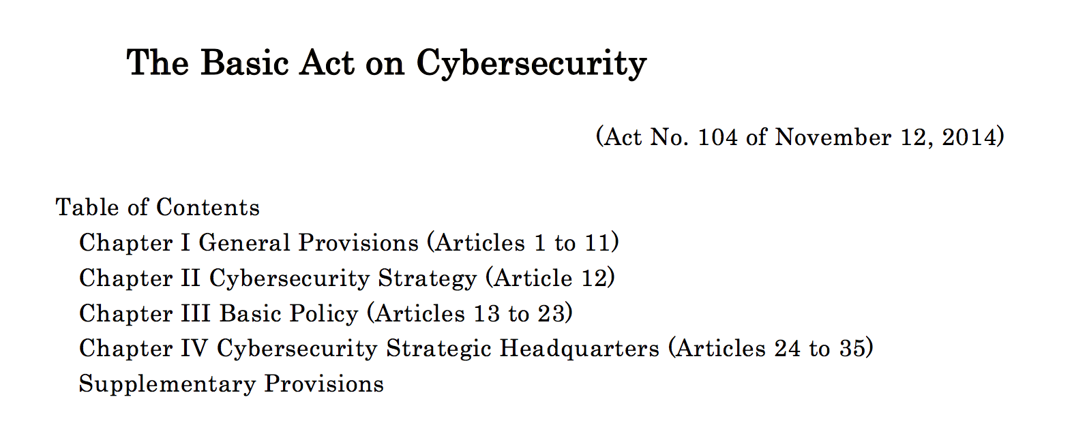

Slide 16
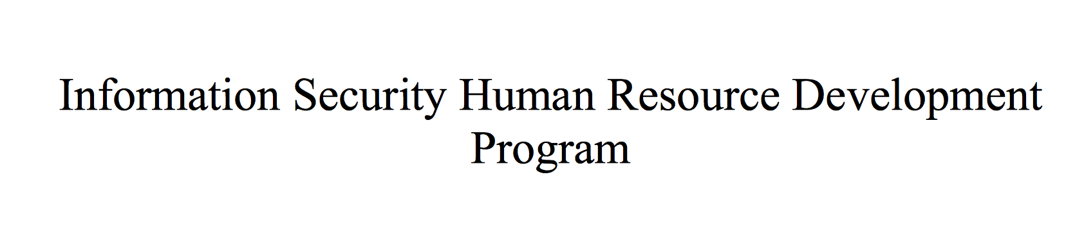
Human resource development 30,000 people
Tokyo Olympics · Paralympic Games(2020)
Cyber Security Human Resources Development Study Group
  43 important infrastructure participation
New employment opportunities

Slide 17
Know past cases
Do you know the following terms?
Computer virus
Cracking
Phishing
Target type attack
Cross site scripting
DoS attack
Information leak (PC, memory theft, loss, administrator cheating)
Lack of information ethics
"It's me" fraud and SNS and free e-mail
Copyright infringement

Slide 18
Information security reader 4th edition - Introduction to crisis management in the IT era - http://www.ipa.go.jp/security/publications/dokuhon/ppt.html
（ Chapter 3 Invisible threats and countermeasures
- Personal level security measures -）of part of slides is reused
Notes:
Information-technology Promotion Organization of Japan

Slide 19
What is malware?
malware(malicious software ) Generic name of malware such as computer virus, spyware, bot
virus：Software that parasitizes other files and programs and makes numerous bad things
spy software：An illegal program installed contrary to the intention of the user or administrator and collecting information such as user's personal information and access history
bot：A malicious program that intrudes into the user's computer and has the purpose of manipulating the infected computer from the outside through the network
Ransomware: Infected computers are restricted from accessing the system 。Payment of ransom is required to the author of the malware to release this restriction 。 There are several forms of Ransomware . Some encrypt the system's hard drive (encrypted virus blackmail) and some others simply disable the system and prompt the user to pay ransom 。(Wikipedia reference)

Slide 20
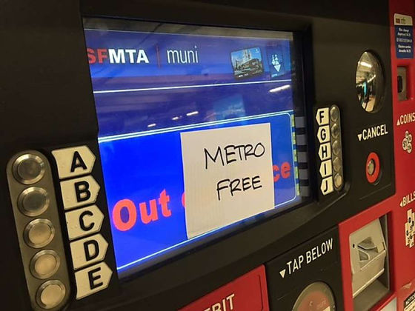
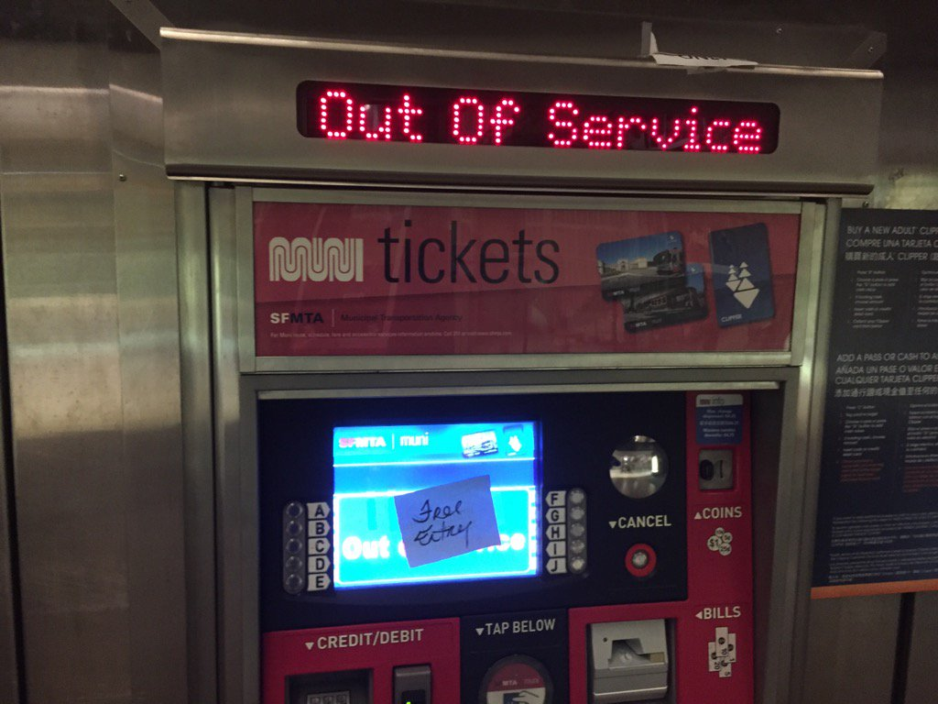
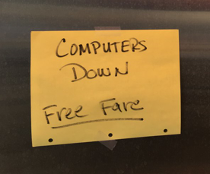
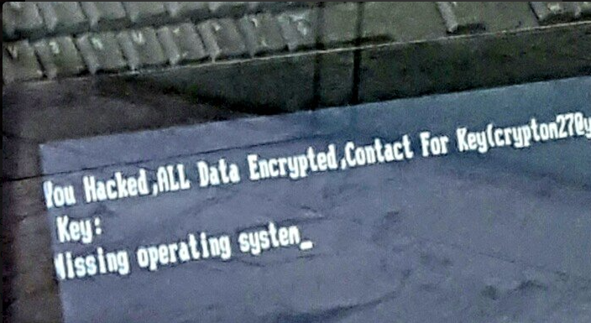
Make the subway free with Ransomware
http://gigazine.net/news/20161128-free-ride-metro/

Slide 21
Damage by Malware
PC penetration is about 20 years
  In 1995 Windows 95 launched
  In 2001 Windows XP launched
Large scale damage by malware
  In 2001 Code Red （ Self-propagating type: worm ）
  7/13 discovery 7/19 Expansion of damage （ More than 359 thousand units in one day ）
  In 2003 Blaster
Large scale damage in recent years
  In 2015 Emdivi （information leakage）
Infection spread through network
Infect infection before updating antivirus software
Self-satisfied type shifted to money damage type

Slide 22
What happens when infected with malware?
Information leakage
Guide to malicious sites and downloading more malware
Complicit in DDoS attacks
Massive transmission of virus mail and spoofing of sender address
Stopping antivirus software or disturbing access to the website
Other symptoms

Slide 23
Information leakage
Information leakage by P2P file exchange software
  The data in the personal computer shared to network
  W32/Antinny (August 2003) etc.
  Publish all the information in the personal computer(2006)
    Exposed virus (Yamada Alternative etc.)
    It functions as a Web server and publishes all the files inside the hard disk on the Web.
Steal information by spyware
  Send an e-mail that says an actual company name or government agency, let the user open the attached file, and spyware (such as keylogger) is putted in.

Slide 24
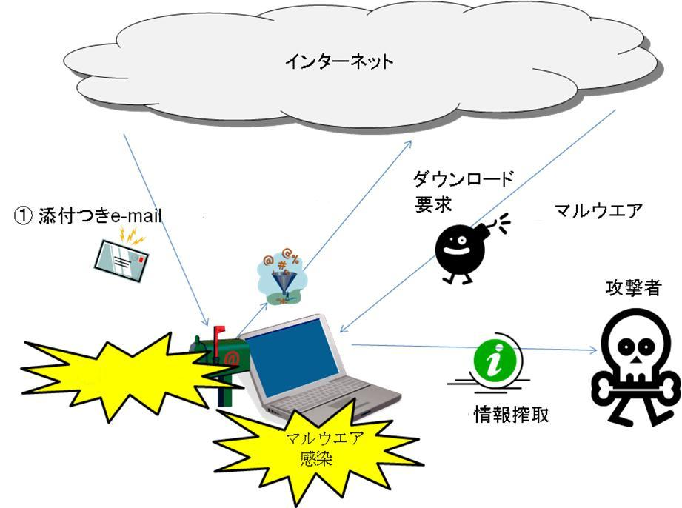
Guide to malicious sites and malware downloads
Internet
Requirement of download
Email with attachment
③
malware
④マルウェアの
ダウンロード
download malware
attacker
②Infected with vulnerability attack
Steal information
⑤
Malware Infected

Slide 25
Virus delivery to internal net
Contents filter
Virus checking
Internet
Firewall
Click!
WWW
SSL encryption
by Tetsuji Kuboyama

Slide 26

DoS attack
DoS (Denial of Service attack)
Due to abnormal communication
  Pressure on network bandwidth
  Pressure on server processing
DDoS (Distributed DoS)
  Attack using multiple servers
  In 2013 September , Kyushu University network is also damaged by DNS reflection attack

Slide 27
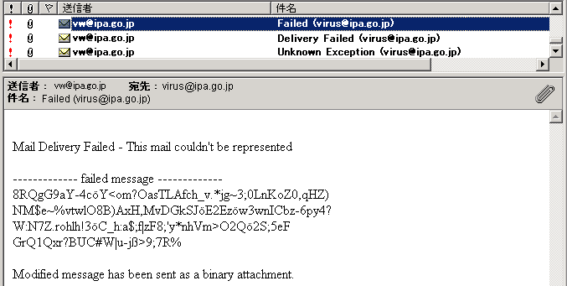
Massive transmission of virus mail and spoofing of sender address
Spoofing the sender → Can not contact the real infected person
→ Open e-mail and think from acquaintance
→ Cheat famous companies and support centers
Send a large number of virus mails → Infection damage is enlarged
Example of virus mail
Spoofed
sender
address
・Infected when opening email attachments
・Text pretend error notification

Slide 28
Stopping antivirus software or disturbing access to vendor website
  Virus signature not to be detected / exterminated
  ・ Stop antivirus software
  ・ Stop the firewall function in the PC
  ・ Do not let anti-virus software vendor's site access
  e.g.： W32/Klez W32/Netsky W32/Bagle
When antivirus software is compatible with the virus
Antivirus software will remove the virus before it is stopped
→ It is victimized if you do not update antivirus software and you can not detect and clean the virus
Update antivirus software on a daily basis regularly ！
→ You can also use automatic update function

Slide 29
Other symptoms
Internet becomes unusable
  E.g.: W32/SQLSlammer
The computer repeatedly restarts
  E.g.: W32/MSBlaster
Work a phishing scam
  E.g.: W32/Mimail

Slide 30
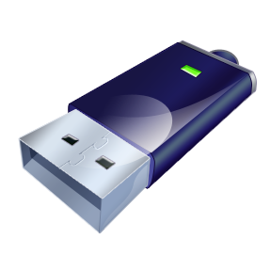
Cause of malware infection
Infection by connection of USB memory
Infected by file open
Infection by browsing Web pages
Infection by mail opening and preview
Infection by connecting to the network

Slide 31
Infected by file open
Infected when opening email attachments
The following file acquisition path is also used
  Download, P2P file exchange software
  Via IM (Instant Messenger) or SNS
  External files such as CD and USB memory
A clever way to lead user mistakes
  File name that attracts users
  Double extension, icon disguise
  Pretending to be a public institution (exploit organization name etc)

Slide 32

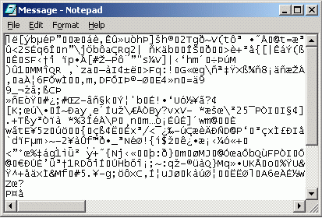

Duplicate extension and icon disguise
To disguise the icon
Launch a program corresponding to a disguised icon
Double click
Launch a program (Notepad) corresponding to the disguised icon
Virus file that appears as a text file
While launching a program that opens a text file and tricking it, viruses are starting to work in places we can not see 。

Slide 33
Pretend to be a public institution
②
⑥
① Subject considered to be interested by mail recipients
② The address of the organization that the sender's email address is likely to trust③ Subject related to subject
④ Attachment name matching the content of the body
⑤ If the attached file is a ZIP,PDF file etc.
⑥ ②Signature including organization name and personal name corresponding to
①
③
⑤
④

Slide 34
Infection by browsing Web pages
An attacker may set a virus on a web page
Unless vulnerabilities are not resolved, you may be infected with viruses simply by viewing web pages

Slide 35
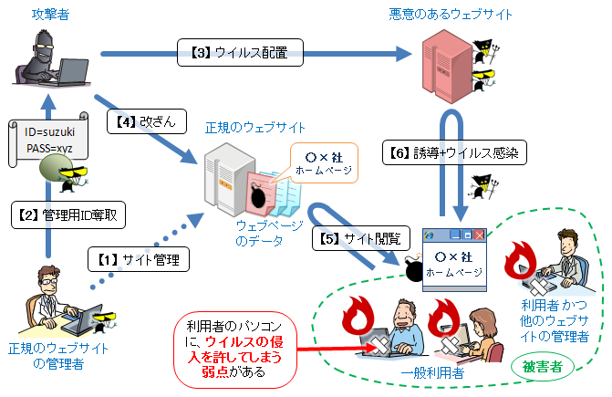
Cracking
Sometimes called hacking 。
Server software vulnerability attack
  Stack overflow attack
  Target type attack
Tampering of the website
Leakage of confidential data
Gumbler
(Mechanism of a series of attackers)
http://www.ipa.go.jp/files/000016378.png
attacker
Malicious site
3,config virus
4,tempere
Regular page
oo_company homepage
5,mislead and infect the virus
2,take the manager ID
Data of webpage
5,view site
1,manage site
oo_company homepage
There is a weak point that allows the user's PC to invade the virus
User or other site manager
Regular site manager
user

Slide 36
Cross site scripting
If you set the ID and PASSWD to be saved in the site, your information will be taken at the time when cookie is taken.
https://www.incapsula.com/web-application-security/cross-site-scripting-xss-attacks.html

Slide 37
Infection by mail opening and preview
Misuse of vulnerability of mail software and OS
If you do not resolve the vulnerability, just open the e-mail or preview it and infect the malware

Slide 38
Infection by connecting to the network
Exploit OS vulnerability
Send a virus file to a vulnerable computer connected to the network
→ W32/Downad etc.
If the password setting is too weak, the password is captured via the network and infected
→ W32/Deloder etc.

Slide 39
MSBlast ・Blaster http://e-words.jp/w/MSBlast.html
Raging in the middle of August 2003
Worm for Windows NT / 2000 / XP 。
Alias 「WORM_MSBLAST.A」「W32.Blaster.Worm」「W32/Lovsan.worm」
Access TCP port 135 used for Windows file sharing
RPC Intrusion using DCOM (Distributed Component Object Model) vulnerability (buffer overflow)
Register automatically in the registry of the compromised computer → Launch automatically at computer startup
The activated MSBlast randomly selects an address close to its own IP address, and then attacks one after the other
Microsoft released a security fix for this vulnerability on July 17th, and there was no risk of infection if it was applied with Windows Update etc. However, concerns about system failure caused by applying security patches, damage caused by failing to update.

Slide 40
Sophistication of attack
Use others (make it a stepping stone), hide and attack the target
  Denial of service
  Information leakage
  Destruction
  Acquire money
Hide until the time comes and can not notice the infection

Slide 41
Common measures
1） Update (vulnerability resolution)
2） Installing and updating antivirus software
3） Utilization of personal firewall
4） Web browser security setting
5） Risk of surfing and countermeasures
6） Mail software security setting
7） Attention to handling suspicious attachments and spam
8） Other notes
9） For the time of emergency

Slide 42
Resolve vulnerability
Vulnerabilities cause malware infections and other attacks
Eliminating vulnerabilities is the first step in information security measures
Utilize Windows Update on Windows
Apply the patch provided by each software vendor (or upgrade to the latest version)

Slide 43
Anti-virus software installation and update
Install antivirus software on your computer
  http://soft.iii.kyushu-u.ac.jp/a-virus/sy.html
Regularly update the pattern file (definition file)

Slide 44
Utilization of personal firewall
The firewall prevents unauthorized access from outside and intrusion of malicious programs
Prevent illegal information transmission of spyware and viruses
It is important to properly set up and operate a firewall

Slide 45
Web browser security setting (1)
Browser security setting = "medium" or more
In the Internet zone
In Internet Explorer"Tools" - "Internet Options"→ Security tab
Security
Level = Medium

Slide 46
Risks of surfing and countermeasures (1)
We can not approach suspicious sites
  Because traps are set up in various ways, vulnerability will hurt you
Do not download or install easily
  There is a possibility of accidentally downloading Trojans and keyloggers
Do not enter personal information unnecessarily
  In order not to suffer the damage of the phishing, input of the credit card number and so on is kept to the minimum necessary
  Check if SSL is used

Slide 47
Risks of surfing and countermeasures (2)
Use of SSL method
Internet Explorer
For SSL communication, http: //become https: //
A key mark appears
Firefox

Slide 48
Mail software security setting
There are many virus infections via e-mail attachments and mail body links
Besides viruses, it is being exploited for phishing
Also utilize security settings of e-mail software
Windows Live Mail "Tools" → "Security Options”
Thunderbird is "Tools" → "Options" → "Security"
※Other mail software also has similar setting items.

Slide 49
Attention to handling of suspicious attachment and spam mail (1)
Principles do not open suspicious mails and attached files
Perform virus inspection before opening or executing attached file
Check the extension and icon of the attached file without being distracted by the appearance

Slide 50

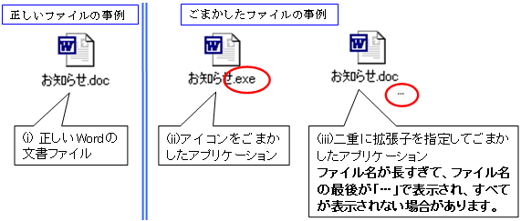
Attention to handling suspicious attachments and spam (2)
Examples of dangerous file extensions
Impersonation example of icon and file name
Normal file
Cheating file
Note.doc
Note.exe
Note.exe
….
This is the normal file
Application that cheats icon
An application which cheat by doubling the extension

Slide 51
Setting to display extension
Put a check

Slide 52
Other notes
To take advantage of the application security features
Do not enter personal information on computers that can not be managed by yourself
Pay attention to USB memory handling
  Do not connect a USB memory that you do not manage
  Do not connect to a computer that you do not manage
  Disable the automatic execution function of the USB memory

Slide 53
For the time of emergency
Be sure to back up data for emergency
Do not miss signs of virus infection
If you get infected with malware
  Report it to the system administrator, calm down and obey the decided procedure
The most safe and sure thing is to initialize or reinstall

Slide 54
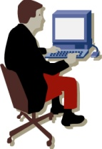

What is phishing scam?
Sending an e-mail that pretends to be a financial institution (bank or credit card company) and acts of defrauding personal information such as address, name, bank account number, credit card number
Phishing scams
Regular site
Fake site
Make an appearance as a legitimate site and enter the user's ID and password
mail
By pretending to a legitimate site and guiding it to a fake site, the user will be deceived and important information will be leaked out.
A person with malice
Get important information such as card information
user

Slide 55
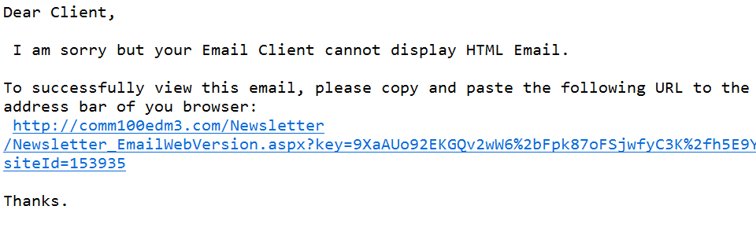
Phishing
Let reader to the site (URL) that he do not wants to by e-mail, and then mislead them to accesses it, erroneously inputs ID, password, etc., or downloads illegal software
  If there is trouble with the site you are using, please reset the ID / PWD as soon as possible ！
  If the mailbox is about to overflow, please login immediately and delete unnecessary mail
  I uploaded a photo of the athletic meeting yesterday. Please check ！
  Pretend to scan the PC, present a list of viruses, urge the purchase of software, steal credit card number etc.

Slide 56
Clever trick
Deceptive mail to mistake users
  It closely resembles the address of a real company
  A believable text
A fake Web site that sees like the real one
  Use a real company name or logo
  Exactly the same design as a real site
Request input of personal information
  The aim is to steal credit card numbers, bank account numbers, user IDs, passwords, etc.

Slide 57
What kind of damage will it be?
Illegal use of credit card
Unauthorized remittance in online bank
Illegal order at EC site
Personal information leaks, there is also the possibility of being abused by the transfer fraud
Account unauthorized use
  Hijacking, spoofing
  Massive transmission of spam

Slide 58
Phishing scam - example 1

Slide 59
Phishing scam - example 2
A pattern that is set on an email attachment file
Trying to steal a user ID, password by random number table.
Click the attached file to display the screen on the right.

Slide 60
Example of phishing mail (1)
http://hiroba.dqx.jp.clud.usa.cc/account/app/svc/login.html

Slide 61
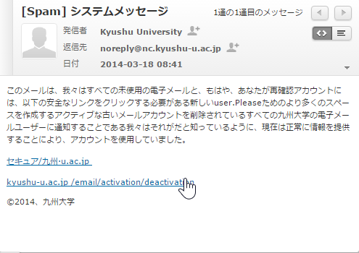
Example of phishing mail (2)
System message
Source of lie
Cheating message: “Please click the link shown below for management of account”
http://www.contactme.com/53277c9cfdb04600020170d1

Slide 62
Be aware of phishing emails!!!!
Site: https://www.sec.iii.kyushu-u.ac.jp/
Tel: 092-642-7647
E-mail:security-room@iii.kyushu-u.ac.jp

Slide 63
Target type attack
Attack targeting specific individuals and organizations
  Combine various cyber attacks and social engineering methods, carefully investigate the characteristics and network composition of the targeted individuals and organizations, attack and hide, conduct spy activities and disturbance acts
Often started with phishing e-mails and website tampering created in consideration of target characteristics
  Since it is a customized attack for the attack target, it is difficult to protect with the usual security countermeasure method
The thing that is done continuously for a long time is sometimes called APT (Advanced Persistent Threat) attack

Slide 64
Measures against phishing scams
Do not trust the sender (sender) of e-mail easily
Do not trust the contents of e-mail easily
Do not click on links easily
Confirm whether it is a real site before input
  Make sure that the correct URL is displayed in the address bar
  Do not enter personal information on web sites that do not have a key icon indicating SSL connection
  Use anti-phishing software

Slide 65
Increasingly sophisticated phishing
An attack that steals confidential information by opening malware attached to e-mail occurred
For the latest case, refer to the "Phishing countermeasure council" site
Council of Anti-Phishing Japan ：http://www.antiphishing.jp/
（ Publication of anti-phishing guidelines, case examples of financial institutions fooled by phishing ）

Slide 66
Other security incidents
Information leakage
  PC, USB memory etc. theft and lost
  Misused by the administrator
Information ethical issues
  Inappropriate use of SNS etc.
Scam
Copyright infringement
Survey report on information security incidents 2011 - Personal information leakage editing -
http://www.jnsa.org/result/incident/2011.html

