Slide 1
Introduction to Cyber Security
― To survive in the IT society ―
Secure setting(2)

Slide 2
Secure setting
Learning about strategy for cyber security that individuals can do
Protecting information equipment itself
Protecting yourself information provided to the service
Information handed over on the net
  About the safety of wireless LAN

Slide 3
Protecting the information on the server

Slide 4
Protection of “Account”
“Account”
  “Right” to use the information system
  Various information of users is linked
    Individual identification
    Accumulation of personal information
    Usage history
Protection with account name (user name / user ID) and password is common
  Information should be known only to legitimate users of the account

Slide 5
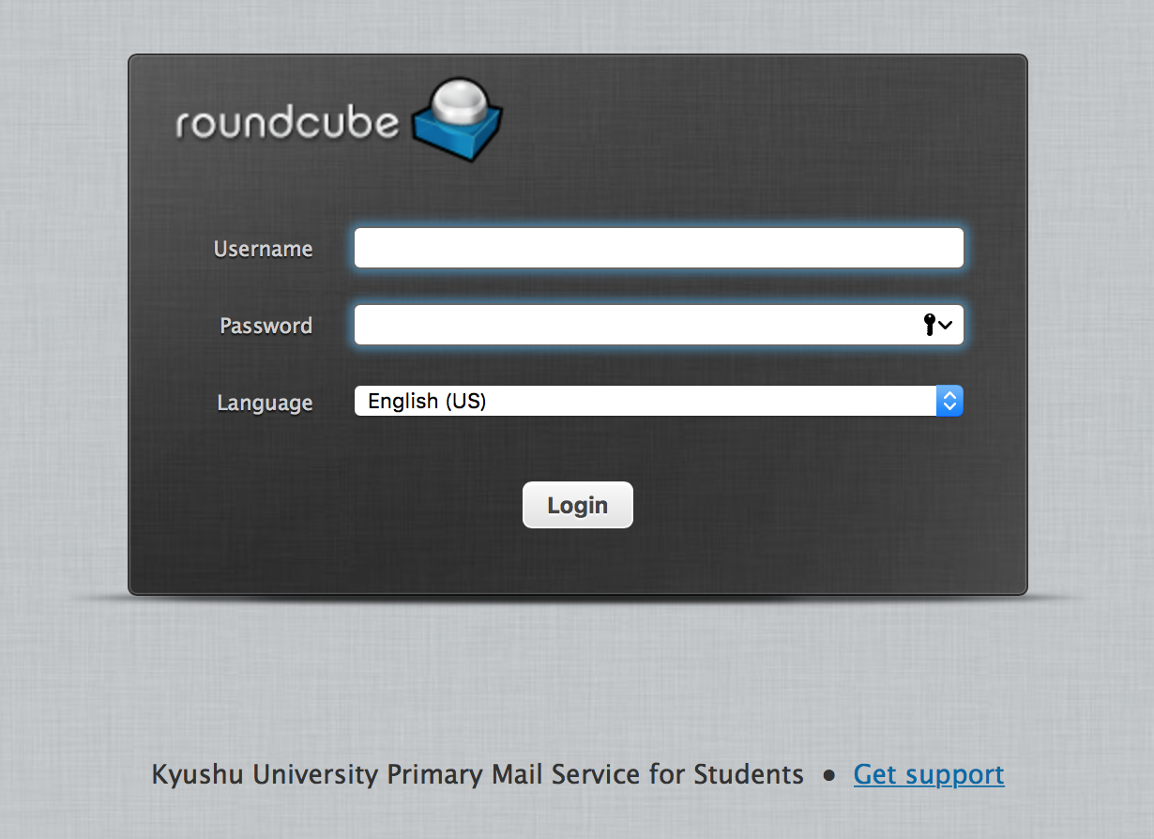
Example of login screen (webmail of of the university)
If "user name" and "password" match, it is judged as a legitimate user
Notes:
The user name is like the room number, and the password is like the key.

Slide 6
Password
Things like "key of room" "key of car"
  Account will be used without permission if content leaks
    Unlike real rooms and cars, even from the back of the earth
Bad people want to hit the victim's password
There are many attacking method
  Brute-force attack
  Leakage from server
  Dictionary attack
  Eavesdropping of communication
  Phishing scams
  etc…

Slide 7
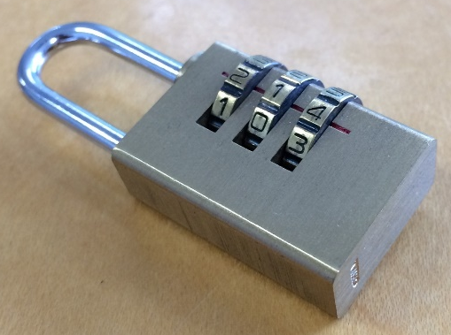
Brute-force attack
Try possible combinations in order
  Person who forgot dial lock number and tried it?
4-digit
  10⁴ = 10,000ways
8 characters with letters and numbers（ Distinction between uppercase and lowercase letters ）
  62⁸ = 218,340,105,584,896ways (218 trillion)
8 characters with letters , numbers and symbols（ It depends on the symbols that can be used ）
  96⁸ = 7,213,895,789,838,336ways(7,210trillion)
10 characters with letters and numbers
  62¹⁰ = 839,299,365,868,340,224

Slide 8
Brute-force attack
It is difficult to contact the server directly in reality
  It takes too much time over the network
  It is easily noticed by the administrator since it is frequent.
    Since failures are also recorded
  Many services locked when failing multiple times
It is often used when password information is leaked from the server
  Is the brute-force attack necessary for stealing information？

Slide 9
Password hash
Normal passwords are not stored in the server as they are
  Convert and save with a mechanism called "one-way function" "hash function"
    The converted character string is "password hash"
  Inverse conversion from password hash to plaintext password is not possible
plaintext password
password hash
123abc
GAEuET5fv5t3Q
Notes:
Hash: How to convert data of arbitrary length to fixed length data
The hash value of a book also changes if one character changes .
It is also used for checking whether the data has not been tampered with
This hash is an old formula and is not used anymore
There is also work which can not be calculated in advance

Slide 10
How to check the password using hash
User sends password
The server converts the password with a hash function
Compare with stored password hash
If they are the same, password is correct
The administrator does not know the user's password
Even if the password hash is missed, the password will not be known
Notes:
Is it not usable with encryption? It is useless

Slide 11
Brute-force attack because it is unknown
Theoretically strong hash functions are limited
  It can be known what are generally used
  If calculating with the same mechanism ,it can be hit
Recent calculators are very fast
  It can calculate billions of times in one second even at home PC
  It can also be calculated in advance
Even that , it still will take long time to reach a long and complicated password
Notes:
It seems that you can calculate lightly 1 billion times per second even with recent personal computers

Slide 12
Dictionary attack
It will take long time to trying all combinations
Use a list of passwords which are frequently used
  English words and name
  Password list that leaked for some reason

Slide 13
Reverse dictionary attack
Fixing the password and changing the user name
  There is also a dictionary of user names
Even a little person using an easy password, it will get infiltrated.
The strength of the chain is in the weakest link.

Slide 14
Good password?
Bad password
  short
  Only numbers or lower case letters
  Using the word on dictionary or birthday
Good password
  long
  Mixing English lower case letters , upper case letters, numbers and symbols
  It does not include word, birthday, name etc.

Slide 15
Eavesdropping
Steal input somewhere between your terminal and the server
Terminal at hand
  Eavesdropping key input and screen with malware
Server
  Tamper with contents and trap
  Make a fake site to fill in with phishing
Channel（wireless ,internet etc.）
  Possibility of eavesdropping on unencrypted communications

Slide 16
Password reused problem
Multiple passwords can be remembered!
  It is said that you should not write on paper …
It is easy to reuse the same password.
In case of registration by e-mail address, there are many cases where ID is also used
As a result, if one leaks out, other services will be broken

Slide 17

Usage rotation problem
you@example.com
password
漏洩
Google
you@example.com
password
Facebook
you@example.com
password
iCloud
you@example.com
password
Dropbox

Slide 18
If it is a good password?
If it is a long and complicated password, it can not be done with brute force or dictionary attacks, so it can not be used well?
We must change all when the raw password is leaked by eavesdropping etc.
There are quite a few useless services that do not save passwords as hashes
  Users do not know how management is going
  No matter how complex a password it is useless
  It is too late after knowing information leakage …
Notes:
Service will tell the password in the e-mail is useless

Slide 19
Labor for avoiding reusing
Make a rule so that you do not have to remember everything
  We add a character string which is reminiscent of service names to fixed character string of several characters etc.
However, it is the limit to finish all within the brain ……
  Personally it is possible to memorize it on paper and store it carefully
  It is helpless to hundreds of passwords

Slide 20
Let machine to remember
Opinion that you do not use the save function of the browser
  It will cause trouble if the PC is operated by other person.
  There are also viruses that absorb stored data.
Which is more risky to use the same password without remembering?
Premise that security measures are taken for the terminal properly
  Lock
  Take measures against malware

Slide 21
Password management software
Software and application which encrypts account information of each service at hand and keeps it safely and manages it
  Lastpass, 1Password, KeePass etc.
The ability to generate complex passwords automatically
  A strong password can be protected without remembering each time
Protection of the terminal is more important when using it
  There are cases where it becomes a target of malware
Notes:
Can you see Lastpass screen?
There is a meaning like a bookmark with login information (phishing countermeasure)

Slide 22
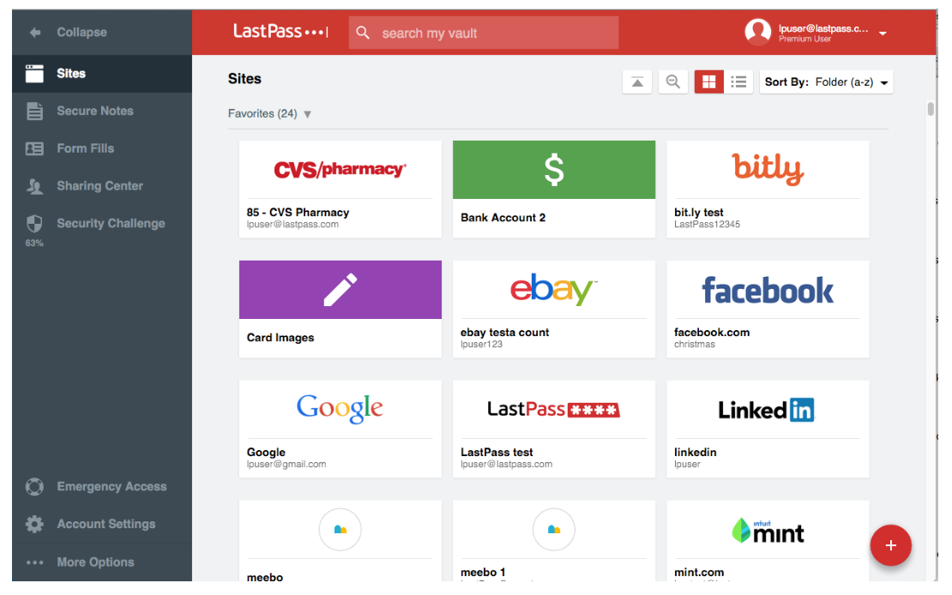
LastPass vault

Slide 23
Multi-factor authentication & Multi-step authentication
Use more than one information for authentication
  Memory： Information known only to legitimate users
    password、PIN code
  Possession： Only authorized users have
    IC card , smartphone of principal
  Biometrics ：Body information of legitimate users
    Fingerprints, irises, veins, etc.
Special equipment which two-step authentication is not necessary is becoming popular in general service
  Usually the premise is smartphone possession

Slide 24
Change of password periodically
Whether it really increases security?
  There is certain effect in the service that the leakage is not immediately known or the damage is expanded if it is leaked
  The same effect can be obtained by 2-step authentication
  There is a danger of using an easy password since changing frequently
  Recently the UK Government Communications Headquarters gave a dissenting opinion
    https://www.cesg.gov.uk/articles/problems-forcing-regular-password-expiry
Some services are forced to make periodic changes
  Moreover, password you used before can not be used
  Use password management software with automatic generation function, etc.

Slide 25
For the "secret question"
Answer questions such as "What is your mother's maiden name?" "What is the name of your first pet?"
  It is registered at the time of account creation, and it is asked at the time of password reset etc.
Actually the security strength is not high
  In many cases, questions can not be chosen freely
  There are a lot of general question contents, and it will be easy to know if search it in SNS etc.
  Research that Google questioned http://googledevjp.blogspot.jp/2015/07/blog-post_8.html
Slightly safe when registering an answer not related to the question text
  Measures not to forget
Notes:
Research by Google

Slide 26
Management of information left on the server
Personal information necessary for using the service can not be helped
Do not leave information that you do not have to leave
  E.g. : Save credit card number in Amazon
    Keeping it is convenient to use for purchase
    Keeping it there will be danger of exploitation by leaking or taking over
  Even when the user can not control it …
    There is also a bad service that saves 'CVC' and 'CVV' which should not be left
    Becoming a trouble since it leaks out
Notes:
Think about what to do when it leaks out
You can check how to contact the credit card company
You can also check how to change your password frequently
Story of Mat Honan
Called Apple's customer support and succeeded in temporary password getting
Google and Twitter accounts linked from there also be taken over.
It can be helped even though measures are taken…
Account of unused service should be deleted.

Slide 27
Protect communication path

Slide 28
What can be protected?
Information equipment itself
  Personal computer & smartphone and its contents
  More safe usage
Information on the service side
  Protection of "account"
Information handed over on the net
  The security of wireless LAN
Notes:
Since eavesdropping on the Internet can not be done directly
It will be safe if it has been properly encrypted…

Slide 29



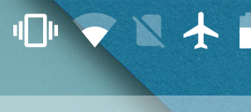
About wireless LAN (Wi-Fi)
One of the mechanisms connecting the personal computer and smartphone you are using to the network
A mechanism different from smartphones and mobile "3G" "4G" "LTE" "Xi”
Most smartphones can use both of those
  Usually it can not be used in the "Garake”.
It is often expressed by the mark of the fan-shaped
iPhone
Mac OS X
Windows 10
Android

Slide 30

What is Wi-Fi?
Wireless LAN equipment based on the IEEE 802.11 standard (described later)
Actually, registered trademark of "Wi-Fi Alliance”
Equipment certified by this group will be given the "Wi-Fi Certified" logo
  Evidence that whether if it passes the examination which to see if it will connect successfully with other Wi-Fi devices
It is almost synonymous with "wireless LAN" at present.

Slide 31
Benefits of Wireless LAN (Wi-Fi)
When using at home (premise that there is a net at home)
  You do not have to loop around the cables
  Even if the equipment increases for the whole family, there is no additional expenses
  The number of machines that support Wi - Fi, such as personal computers, smart phones, tablets, game machines, printers, etc., is increasing.
You do not have to worry about restricting traffic on the mobile phone network
There are things that can only be done with Wi-Fi
  IPhone update, large application download, iCloud backup etc.
Wi-Fi can be used when mobile networks can not be used such as overseas
  Mobile roaming is expensive

Slide 32
There are many standards
name | frequency | communication speed
802.11b | 2.4GHz | 11Mbps
802.11a | 5GHz | 54Mbps
802.11g | 2.4GHz | 54Mbps
802.11n | 2.4/5GHz | 65~600Mbps
802.11ac | 5GHz | 290M~6.9Gbps
IEEE 802.11 - Wireless LAN standard
  The Institute of Electrical and Electronics Engineers, Inc.
Unable to communicate with not using the same standard
  Many devices are compatible with multiple standards

Slide 33
SSID and channel
Connection destination is determined by channel and SSID
  Channel of the base station is usually fixed
    It is numbered like a TV set
      1ch, 2ch, 3ch…
  The slave unit automatically scans and searches for a base station
  SSID is the name of the network
    If the SSID is different on the same channel , it will be a different network
    (SSID: Service Set Identifier)

Slide 34
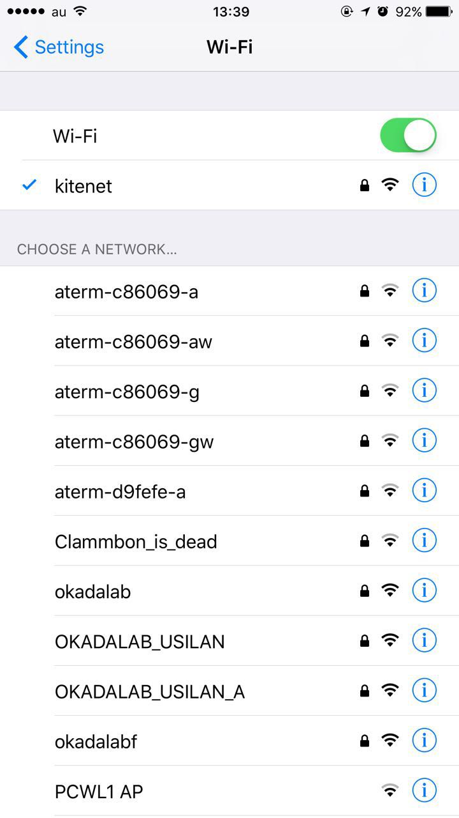
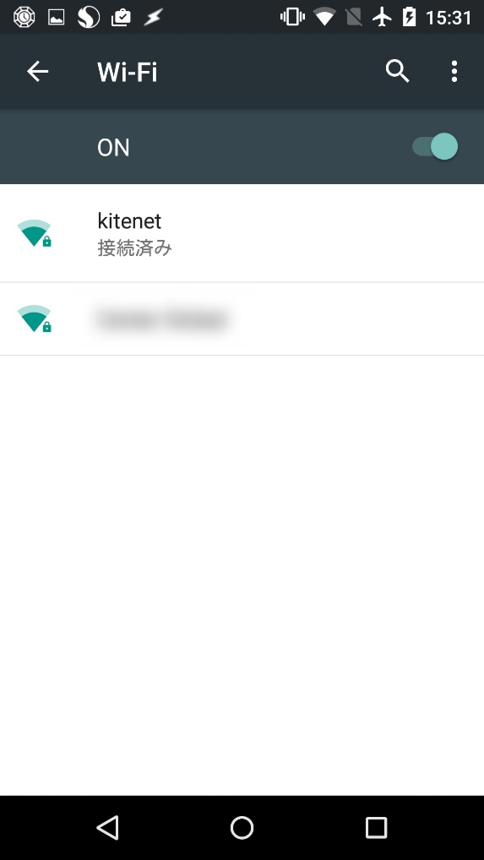
State of SSID visible
connected

Slide 35
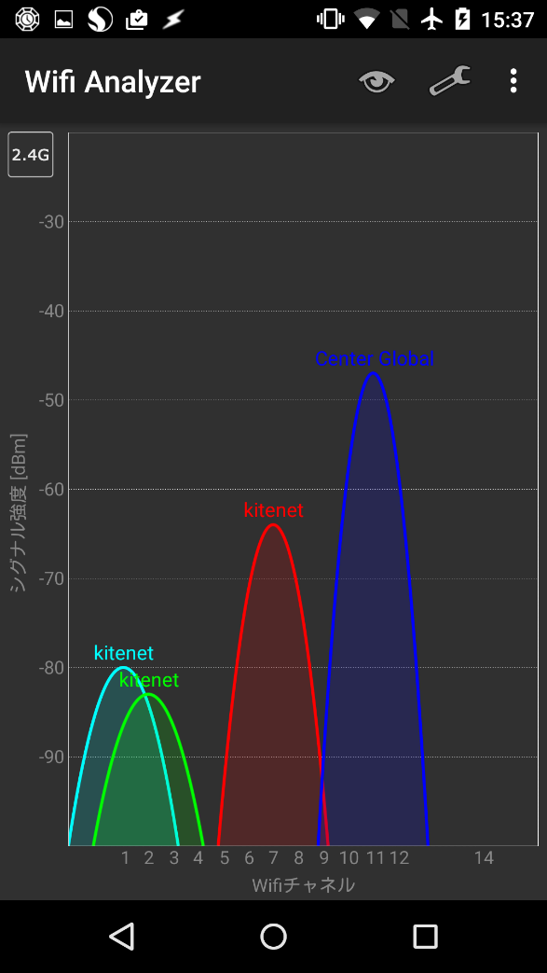
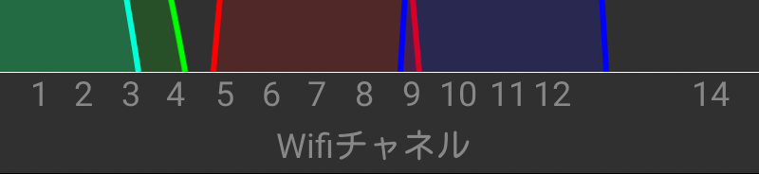
Channel
Wifi Channel
13 channels in the 2.4 GHz band
It overlaps strongly by two channels above and below
  If you do not want to interfere, only three to four can be taken
Channel allocation (not shown in detail) so that 5 GHz band does not originally overlap5GHz
  Up to 19 channels
Wifi Channel

Slide 36
Wireless LAN and encryption
Since it is radio waves, anyone can receive it if it arrives
  Although mobile phones are also wireless, there is a mechanism of encryption and there is no worry about eavesdropping in the wireless section
  Wireless LAN can be easily intercepted by conditions
Wireless LAN that connects without any password also eavesdropping as much as you want
  Whether encryption is supported depends on the setting of the base station
  The slave unit (such as your smartphone) can only follow the setting of the base station
Sometimes even password protection, it can be eavesdropped if its password is known to the other party

Slide 37
Wireless LAN security
WEP: Wired Equivalent Privacy
  Connection and encrypted with a shared key that you set in advance
  Protection of encryption key is weak and danger is high
WPA: Wi-Fi Protected Access
  It was made to replace WEP
  A standard designed to be used even on old machines
WPA2: Wi-Fi Protected Access 2
  Currently the strongest standard
  Since it uses a strong (processing complicated) cryptography , sometimes it can not be used on old machines

Slide 38
Wireless LAN security
High level
WPA2
WPA(Wi-Fi Protected Access)
WEP(Wired Equivalent Privacy)
No protection (open)
As well as without protection
Low level
Notes:
WEP requires caution as it can be deciphered in a short time using tools and it is in the same condition as without protection
It feels like better than nothing. But it may seem like it is being protected , so it may be rather bad.

Slide 39
WPA/WPA2
WPA / WPA 2 can use multiple authentication / encryption methods
For home base stations PSK is common
  Pre Shared Key
    Sometimes it is written as Personal
  If you try to connect you will only be asked for the password
Kyushu University uses a method called Enterprise
  When you try to connect you will be asked for individual ID and password
  Eavesdropping of others is difficult because it does not use a common key
  Requires separate authentication server for company

Slide 40
Points to keep in mind when placing a base station at home
Others use freely
  Risk of being treated as a criminal by being used for illegal conduct
Eavesdropping from others
  Personal information may be stolen
  Family members may also be affected
Enable security function to prevent these things

Slide 41
People who have a base station at home
Set security to WPA 2 - PSK
  It may be better to replace old base stations that are not compatible
  WPA-PSK also is inevitable when the slave unit is not compatible
    There are cases where it is possible that base stations to deal with both
  Do not use WEP or without a password
The longer the password is the better
  Can not analogize from SSID
  It can be set with 8 to 63 letters in WPA / WPA 2-PSK
SSID does not have to be forcibly changed
  Recent products contain random character strings for each device

Slide 42
If you use elsewhere of the base station
Free public wireless LAN
  Fukuoka City Wi-Fi
  Convenience store Wi-Fi
  Café Wi-Fi etc.
Wireless LAN that requires paying contract
  Wireless LAN provided by mobile carriers etc.
Wireless LAN available only to customers such as hotel Wi-Fi.
  When you check in it will tell me how to connect

Slide 43
Mainly used authentication methods
No authentication
  Convenience-oriented, it referred important to connect
No wireless LAN authentication + web authentication
  It connects to wireless, but it does not connect to the Internet
  When you enter the necessary information on the web screen you will be able to go outside
WEP/PSK（ + web authentication ）
  Password is required in addition to SSID
More robust method
  Enterprise type (register user name and password in advance)
  Using contract information of mobile

Slide 44
Check base station settings
It can not be judged whether it can be used or not when the base station can not know the partner …
It seems a little troubled because there is a tendency on the recent terminal that information does not come out ☹

Slide 45
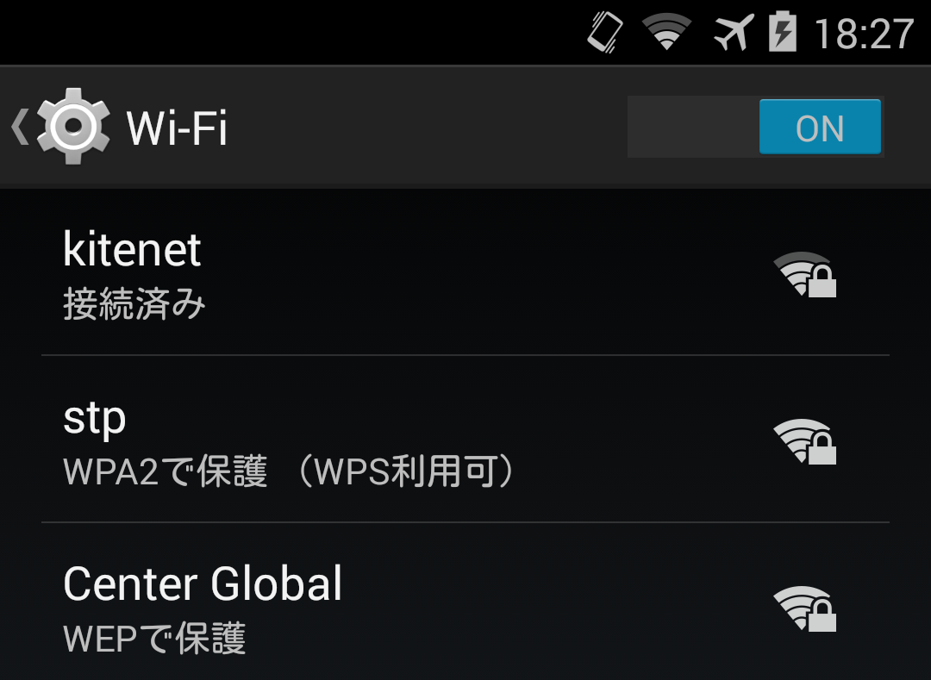
Confirmation of Android
connected
Protected by WPA(WPS is available)
Protected by WEP
Notes:
(Kitenet is displayed as 802.1x ...)
There is no way to check on the iPhone!
Windows 8 is not displayed in the list ...
On the Mac, hold down the option key and click the fans icon

Slide 46
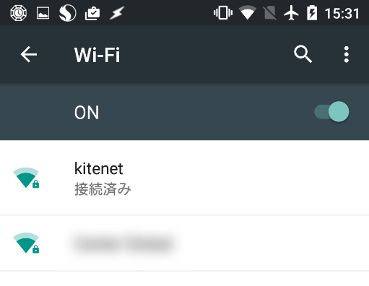
Android 5 (Lollipop)
connected
Other than small key mark
It came out …

Slide 47
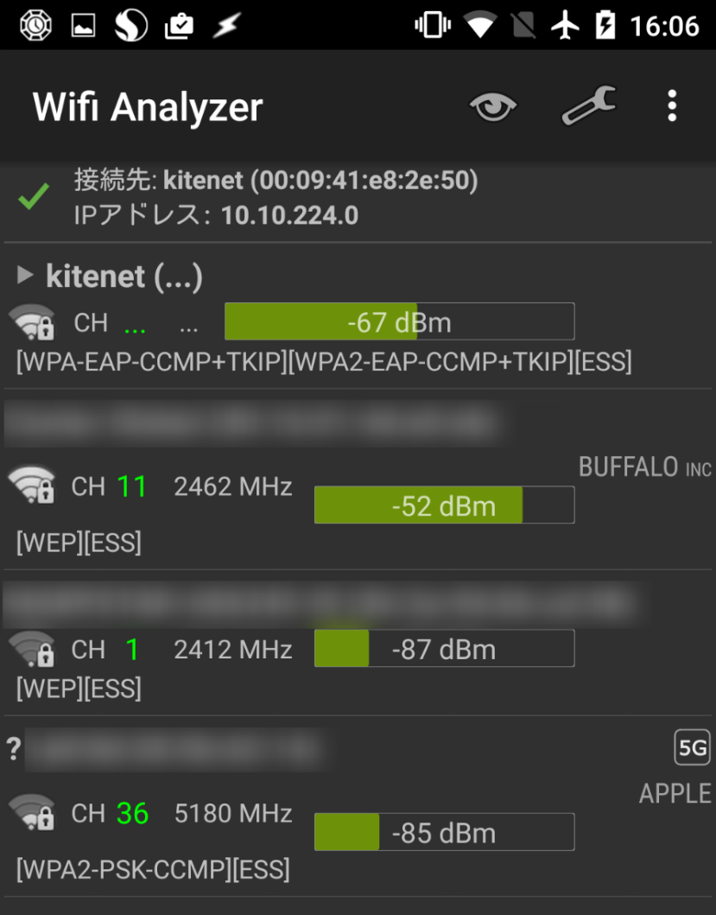
Wi-Fi Analyzer (Android アプリ)
http://wifinalyzer.mobi

Slide 48
Can be displayed if connected
Notes:
"None" or "WEP" is a little worried ,we do not want to use if possible

Slide 49
Windows 10
（ Only you know that it is protected ）

Slide 50
After the connection , the detail will be known

Slide 51
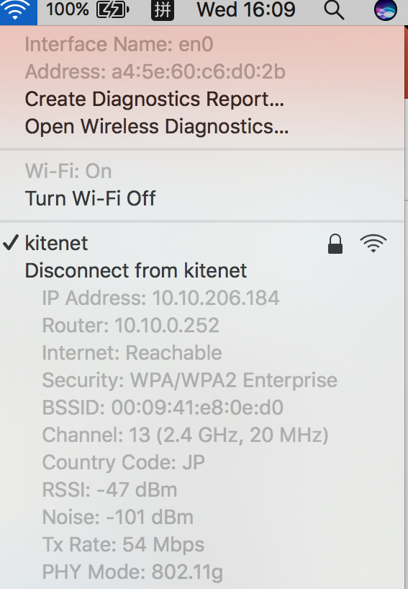
Mac OS X can be known in detail
Hold option key and click fans icon
Detailed information of the connected radio base station is displayed
Hold down the option key and move the mouse pointer over the SSID to see the details even if you are not connected

Slide 52
Who cares? …
If you are a leading mobile carrier, the following SSID is a strong mechanism so relatively safe
  0001docomo
  au_Wi-Fi2
  0002Softbank
However, apart from docomo, it seems that it can use only the terminal with mobile contract
Avoid without authentication as much as possible
  It is inevitable if there is only such connection means
Even in the case of PSK, it is possible to be eavesdropped if you know the password
  In the case of public wireless LAN sometimes it is published

Slide 53
Those wireless LAN is weaker than wired
At present, when you use the public wireless LAN , it has no choice to do even if it is tapped
  The usage agreement also says "Please use it at your own risk because there is a risk of eavesdropping”
Normally important communication is encrypted by another method
  Because there is the possibility of eavesdropping on the Internet itself

Slide 54
Risk of "Nara Wireless LAN"
A wireless LAN that is not locked, not for public use is found sometimes
  Since it is not locked, it seems to be usable if you connect it, and usually you can actually use
Do not know who set up, maybe it is malicious ?
  Danger such as guidance to eavesdropping / fake site
Do not use wireless LANs whose identity is unknown

Slide 55
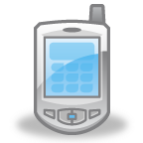
Eavesdropping and attack by trap base station
Internet
Fake SSID
Eavesdropper
Fake site
Terminal
Notes:
電波は空間を飛ぶ

Slide 56
Public shared terminal
（ It is not related to wireless LAN…）
Internet cafe · hotel lobby etc.
  Free, things you can use per hour
Do not know how to manage it
  There is a possibility that it has been infected by virus and keystroke or eavesdropped on the screen
Do not absolutely enter your password, credit card number, etc.
  Do not use sites that require such input
Just looking up tourist information

Slide 57
What do you do when you are on a business trip as a company person?
Using the VPN connection
  Encrypted communication between the terminal and the company's VPN connection device
    It is encrypted on the wireless or the Internet and can not be read even if it is eavesdropped
  It is not offered at Kyushu University
Using the mobile router
  Compact wireless LAN master unit that can connect WiMAX or LTE
    Avoid WLANs with unknown features
  There is also kitenet WiMAX which connects directly to the network of Kyushu University (but is it slightly expensive for students?)
    https://jvr.uqwimax.jp/univ/kitenet
Tethering

Slide 58
Summary
Specific measures that can be done by individuals
  Protection of belonging personal computer · smartphone etc.
    Lost or stolen countermeasures
    Malware countermeasures
  Protection of used services
    The handling of the password
  Protection of communication path
    About the security of wireless LAN
    How to use shared terminal

