Slide 1
Introduction to Cyber Security
― To survive in IT society ―
Research ethics・information ethics

Slide 2
Researchers are
People do research as a profession
Belong to「Research institution」in many cases
  Research institution
    Universities
    Corporate laboratories, research departments, etc.
Become researcher with education・training for research
  Graduate school（Master’s course・Doctor’s course）
  Laboratory
    Organizations for fostering researchers and researching in groups
Evaluated by research results
  Research paper
  Others （Patents etc）

Slide 3
Research is
Find possible questions in existing knowledge、conduct scientific experiments against it、get new findings based on the result
  Base on existing knowledge, add new knowledge
  In many cases, present in the form of a paper
「Previous research」
  Relating to a research theme, conducted research in the past
  It is often published in the form of a paper
    Investigate databases → Importance of search
    Investigate in library→ Importance of university’s library・research library
  「Standing on the shoulders of giants」 by Newton
  When writing a paper, cite research

Slide 4
Paper is
Paper which explains research results logically etc.
  Main forms of researchers present their research
Posted on Academic journal（Representative shape）
  Examination (review) exists before publication →Peer・Review
Author of a paper
  Those who wrote the paper, conducted the research which in the paper
  It is written as 「author」 of the article
  Responsible for the content of the paper (= research)
  Achievement
    「Author of a paper」、is evaluated by writing that paper
  Please properly select and properly describe the author (Authorship)
    Inappropriate author's description is cheating

Slide 5
「Citation of a paper」
A way to touch the previous research when writing a paper
  Cite previous research to show legitimacy and importance of your paper and grounds for content
Important prior research to your research、have to cite it properly（Rule of paper writing）
  To mention the contents in the text or to describe part of the text of the original thesis
  Write bibliographic information (paper title, author name, publication title) in the column of 「references」 in the paper

Slide 6
Evaluation of research
Evaluation of paper
  Important knowledge or social influential knowledge
Indication
  Be cited in many papers in「previous research」
  A paper with more citation（cited number）is「Important paper」
  「Which papers cite which papers」are made into database
    Citation Index/Impact Factor
  Researcher's Evaluation
  Research institution (university)’s valuation

Slide 7
Reference material of CITI Japan's teaching materials
CITI Japan is
  Collaborative Institutional Training Initiative
  E-learning program for scientific research and medical education
  Education of Research ethics

Slide 8
Contents
Responsible research activities
Misconduct in research
Joint research
Conflict of interest
Authorship
Peer review

Slide 9
Research ethics = responsible research activities
Research is
  Find possible questions in existing knowledge、conduct scientific experiments against it、get new findings based on the result
Values commonly to be held
  Honesty
    Tell information honestly and do sincere sincerity.
  Accuracy
    Accurately convey the obtained findings without error。
  efficiency
    Use resources effectively without waste.
  objective
    Express the fact as it is. Do not add personal findings.

Slide 10
There are no rules for responsible research activities
- Case -
Scientist's Code of Conduct (Science council of japan)
  「Scientists, positively publish and explain meaning and role of the research that they engage、evaluate the impacts and possible changes that the research can have on human beings, society, environment、publish the results with neutrality and objectivity、try to build constructive dialogue with society」
Special committee report on misconduct of research activities (MEXT)
  「Publication of research results、present objective and verifiable data and materials、public to the researcher community、for results obtained by research activities、receive a review and criticism about its contents」

Slide 11
Different government regulations in the US and Japan
America
  Congress grasps the problem of researchers and Congress establishes regulation
  Clear penal provisions
Japan
  Decide research regulation through discussion between administration and researcher
  Ambiguous penal provisions
In Japan, regulations for preventing fraud in research are gentle, depending on the ethics of the individual.

Slide 12
Misconduct in research
Fabrication・tampering・stealing
  Fabrication is、creation of data that does not exist, research results, etc.
  Tampering is、conduct operations to change research materials, equipment and processes、data、 change incorrect results obtained by research activities.
  Stealing refers to the idea of other researchers, analyzing・analyzing methods, data, research results, articles or terms、divert contents without consent of the researcher or proper display.

Slide 13
Examples of suspicious research actions
Do not (precisely) record the research process or results on research notes (including electronic files).
Do not keep research notes, important research data, research materials for a prescribed period.
Do not keep research records that have already been announced and research records useful for other researchers so that they can look back on at a later date.
Add to co-authors even though there is no contribution to research results（Gift・Authorship).
Authors have contribution to research results but not be added to co-authors (Ghost・Authorship).
Refuse to provide study notes, important research data, research materials for research fraud investigation, in this case, there is a high possibility that the rejection activity itself is judged to be research fraud itself.
Research supervisor do not adequately provide research guidance to students and graduate students .
Laboratory academic advisors exploit student・graduate student’s data・research results.
Do not properly cite previous studies.

Slide 14
Collaborative research with (company)
Problems that can occur in collaborative research
  Different attitudes among individual researchers
  Differences in research styles across region and region
  Difference between attitudes of universities and companies concerning research data and sharing results
  Difference between corporate strategy and economic needs of researchers

Slide 15
Notes on collaborative research
A thorough investigation prior to the start of research
Communication
Sharing recognition of role sharing and its liquidity
Discuss beforehand about the authorization (qualification becoming the author of the thesis)
Discuss beforehand the handling of data, research materials and samples
Establish leadership
Clarify the responsibilities of each researcher

Slide 16
Conflicts of interest
Conflicts of Interest is
  By considering money or other personal interests、a compromise or deflection arises in the judgment made as an expert、there is a possibility that objectivity may be lost

Slide 17
Conflicts of interest that may arise at the individual level
Often due to academic thought (one without shape).
  The desire to prove the opinion.
  The silence of data not matching the hypothesis of principal believes.
  Excessive trust for a specific theory.
  Special thoughts and emphasis on the theory advocated by groups I like.
  Pressure from inside and outside, that must get results.

Slide 18
Authorship
Rule of authorship(Sample of International Committee of Medical Journal Editors （ICMJE)
  Concept planning and research, collection of data、or substantially contributes to either analysis of data and interpretation of analysis results.
  Involved in writing manuscripts of manuscripts or a crucial proofreading ・ revision work related to the contents of the paper.
  Understand and approve the contents of the manuscript of the final version to be posted。
  With regard to all aspects of the paper, which can explain properly when doubt is gained in the accuracy and authenticity of the paper。

Slide 19
Examples not allowed as an authorization
Acquisition of research funding, research group summary、for both business assistance in general and writing assistance, technical editing work and language editing and reviewing work、with that alone、can not be recognized as a contribution worthy of the author。
  Should be written in acknowledgment

Slide 20
Peer review
Review・Examination by experts in the same field
In scientific research, it is the highest quality that experts in the same field peer review and examine each other、is widely accepted today as leading to fair evaluation。
Peer review
Single・blind
  Face down reviewer’s name to the author
Double・blind
  Do not know any about authors and reviewers

Slide 21
Ethics of Reviewers
confidentiality
Constructive criticism
Eligibility
Imbalance・fairness
Disclosure of conflicts of interest
Readiness

Slide 22
Know and think about information ethics
Information ethics and information moral
Kyushu University Information Ethics Policy
Relationship and information ethics between humans, things and computer networks
Information Ethics and Law
Case based on information ethics (Trouble of SNS)
Case based on information ethics (Administrator’s misconduct)
Information ethics and copyrighted material

Slide 23
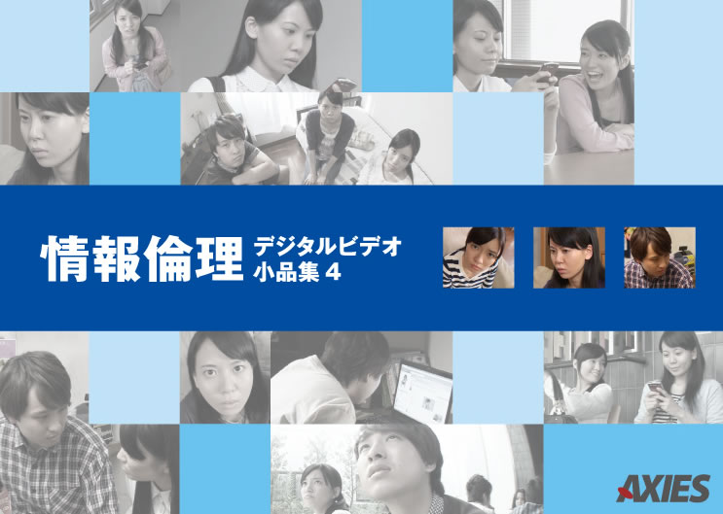
Information ethics and information moral is
Information ethics
  Information ethics
  A general code of conduct required for human society’s formation using information.
  In order not to adversely affect the society as a whole in dealing with information、a concept of trying to form a better society
  Ethics：Conjugate of moral in community of society（Spontaneous judgment criteria of good and evil），and the core of the norm of behavior
Information moral：The idea and attitude underlying the appropriate activities in the information society」（Guidelines for MEXT）

Slide 24
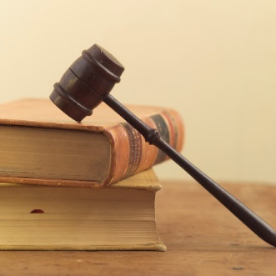
Kyushu University’s Information Ethics Policy
http://www.kyushu-u.ac.jp/university/rule/zenbun/2012kitei073.pdf
By established knowledge, responsibilities, matters of compliance, etc. of those using information assets of Kyushu University、holds the ethics of the user (“information ethics”)、facilitate safe, smooth and appropriate use of information assets、aims at improving education, research, medical treatment and university’s administration ("education etc.") of our university．

Slide 25
Kyushu University’s Information Ethics Policy
http://www.kyushu-u.ac.jp/university/rule/zenbun/2012kitei073.pdf
In using information assets, compliance and prohibition with in-campus regulations established for management and operation of information assets
  (1)Actions are not permitted in use of qualification
  (2)Actions that harm rights and interests of others
  (3)Actions of transmitting false information or information contrary to public order and morals
  (4)Actions of damaging or disrupting information assets
  (5)Other actions that the Information Policy Committee makes inappropriate
Law about users are prohibited for unauthorized access actions, etc in utilizing information assets, （Law No.128, 1999）、Copyright law（Law No.48 of 1965）、Law concerning protection of personal information held by independent administrative agencies（Law No. 59 issued in 2003）and users must comply with other related laws and regulations
Reporting obligation on information security accidents

Slide 26
Kyushu University‘s Security Policy
https://www.sec.kyushu-u.ac.jp/sec/policy/policy2.1.pdf
Accountability to society
  Guarantee for availability of information infrastructure, which has become indispensable for social contribution required for education, research and academics（A state that a person qualified for use can use it whenever it is necessary）
  Measures against external threats
  Control for internal compliance establishment

Slide 27
Kyushu University‘s Security Policy
https://www.sec.kyushu-u.ac.jp/sec/policy/policy2.1.pdf
Composition of management organization
Prevention and treatment of acts that adversely affect information security outside our university
Report on accidents and obstacles, emergency response, information rating and handling restriction rules
Information classification and use authority, information management, disclosure of information, private release
Information tampering and prevention of false information dissemination
Disposition of information system and storage medium
  Use the destruction of the medium itself or a dedicated magnetic erasing device
    In normal erase operation, only management information is erased. The information itself is not erased
    Even with overwriting several times, information can be restored by reading out residual magnetic information
Physical security，human security
Policy implementation, evaluation and review
Digital Forensics

Slide 28
  What is compliance?
The organization acts in accordance with basic rules such as laws and regulations, internal rules, and social ethics。
Social ethics
Internal rule
Laws and regulations

Slide 29
  What is cyber security compliance?
Law：Cyber Security Basic Law etc.
Ethics：Information ethics regulations、
Cyber security policy
Social ethics
Security policy、Information ethics regulations
Cyber security basic law

Slide 30
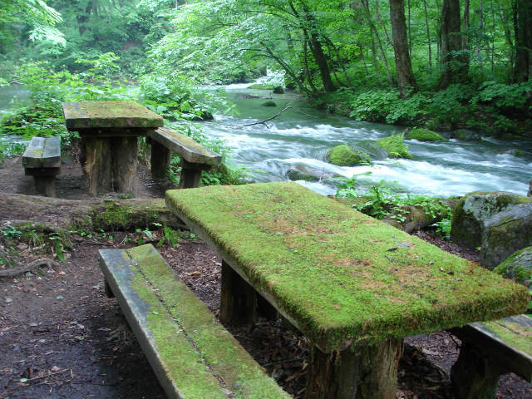
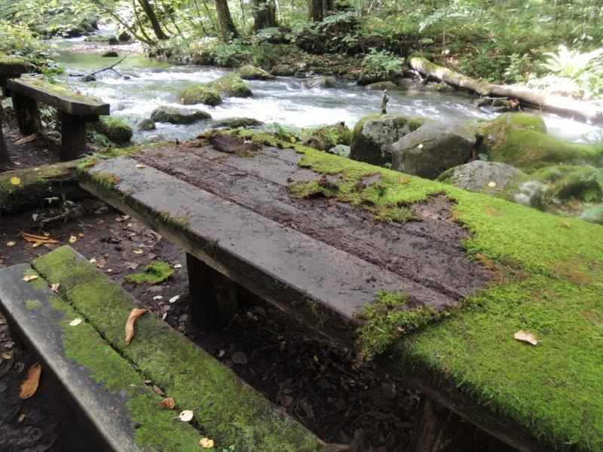
Case that happened at Towada Lake
Ethics: Not stated.
If there is not have a sign saying “Please do not peel off the moss”, can I peel off?

Slide 31
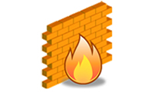
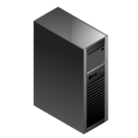

  Security policy
A compilation of policies on handling security concerning information assets in an organization.
Security policy sample1
Security policy sample2
If you apply, you can issue
a server outside the firewall.
You can not issue a server outside the firewall for any reason.

Slide 32
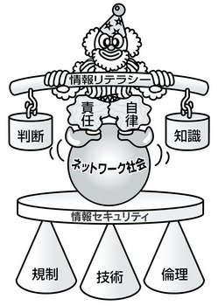
Relationship and information ethics between humans, things and computer networks
Understand both「light」and「shadow」of internet which influence society
Understand personal information and the significance of privacy, acquire appropriate handling methods, attitudes
Understand the cultural significance of copyrighted work, acquire an attitude to respect intellectual property rights including copyrighted works
earn the attitude that the Internet can be used in life
Understand the influence of the Internet on business and acquire attitudes that can be used correctly
Learn the correct knowledge and judgment about information, the utilization of Internet and media
Understand sending and receiving of information using Web and e-mail, learn morals and manner
Learn about information security and computer crime, and acquire attitudes to not become victims・perpetrators
Book “Light and shadow of Internet Ver.4 Introduction to information ethics not to become victims / perpetrators “ Information Education Study Group (IEC) Information Ethics Education Research Group edited by Kitaoji Shobo
http://www.chieru-magazine.net/special/entry-932.html

Slide 33
What is the awareness about information ethics and information security of current general users?
Let's see results of the survey

Slide 34
From report of「Survey for awareness on information security in 2014」 (1/3)
https://www.ipa.go.jp/security/fy26/reports/ishiki/index.html
（1）Behavioral targeting advertisement：Information such as browsing history is collected rather than convenience, and its management is is regarded as anxiety
  「It’s bad to know that my information is gathered by others while I do not know」（54.7%）
  「I am worried about ifcollected information leaks or not」 （36.5%）
It’s necessary to opt-out ad delivery service to disable behavioral targeting ads （opt-out：Refusing to receive advertisements sent unilaterally by companies and withdrawing from registered services, and measures and instruments for that.）
Under Japan‘s revised law concerning anti spam measures implemented on December 1, 2008、transmission of advertisement, advertisement mail, etc. was changed from the opt-out method to the opt-in method until then
There is anxiety about information leakage

Slide 35
From report of「Survey for awareness on information security in 2014」 (2/3)
https://www.ipa.go.jp/security/fy26/reports/ishiki/index.html
（2）Users who are young (teenagers) and users with low proficiency (level 1) for personal computers do not set passwords appropriatly
  "Does password set by avoiding things that are easy to guess such as birthday?" 36.4% (overall 52.6%)
  "Does the password set to characters that are difficult to understand (including more than 8 letters, symbols)"? 39.2% (overall 50.7%)
  Password is different for each service: 15.8% (29.2% overall)
But, they are not careless with password

Slide 36
From report of「Survey for awareness on information security in 2014」 (2/3)
https://www.ipa.go.jp/security/fy26/reports/ishiki/index.html
（3）Number of smart device which users use to make malicious postings increases.
Tendency of lower ethical awareness
  「In order to retaliate opponent（13.2％）」
  「want to argue against people's opinion（32.3％）」
  「want to make it flames up（6.8％）」
  「felt relieved（31.9％） 」
（4）“Even if there is an account of someone else,、If you can log in with guesses etc, keep using Internet service” proportion of users in twenties who doubled from the previous survey
Using other people 's account via the network,
violate unlawful access prohibition law

Slide 37
Examples based on information ethics (troubles in SNS etc.)
Flame up, personal information posting, chain mail, hoax
Fictitious claim of (One click fraud）
Child prostitution・child pornography
Spam from dating site
Same contents, homecoming bulletin boards from dating sites at non-dating sites, 「Dating site regulation law」(Official name “Law concerning the regulation etc. of the act of attracting children by using internet heterosexuality project）Established in 2003, effective December 1, 2008
http://www.npa.go.jp/cyber/deai/law/

Slide 38

Regulation law of dating site
Established in 2003
Making children use the dating site for "those who are under 18 years of age"
Writing to induce a relationship that makes a child sexual intercourse
Writing to induce heterosexual relationships for children
For Internet operators (internet heterosexual introduction companies) of dating sites、is required a notification to prefectural public safety commission. For undeliverable sales, imprisonment of up to 6 months or a fine of 1 million yen or less（Revision in May 2008）

Slide 39
Case based on information ethics (misconduct by administrator)
http://www.ipa.go.jp/security/announce/20140710-insider.html
How internal fraud occurs: Incorrect triangle
  「Motivation・Pressure」：Dissatisfaction with pressure（working volume，norms etc）and treatment
  「Chance」：An environment that enables or facilitates the execution of fraud, within techniques(IT system, network), crane-like environment and organizational rules etc.，
  「Justification」: Reasonable interpretation, reasoning such as pass-through to others to others
Countermeasure example
  Clarify important information, granting appropriate access authority
  Monitor carrying-in of portable media, taking out important information
  Monitoring・auditing for periodical operation history

