Slide 1
Introduction to Cyber Security
― To survive in the IT society ―
Knowing encryption technology

Slide 2
About conduction of class questionnaire
This questionnaire will be conducted for the purpose of reviewing your class, improving classes and curriculum, etc. We will use the data/opinion to improve classes, and we will use it as reference for the core education curriculum in the future.
Please write a constructive opinion with individual responsibility in the column of free description.
Also, we won’t use personal information other than statistical processing.

Slide 3
How to answer questionnaire
Log in to Moodle
"My course" → "Questionnaire" →
Access to "Questionnaire for KIKAN Education Courses, Third Term, 2016" in the first half of 2016 Lecture Questionnaire
It takes 10 minutes time from now
People who did not finish must answer by December 2nd. (Friday) after the lecture ends
  From 3 days before the end of the implementation period, reminder mail will be sent automatically to the unanswered person
Notes:
メールで催促が飛びます

Slide 4
This slide uses part of the lecture material of Graduate school system information
"Advanced topics of cryptography and information security" (mainly cryptography theory 1)
The instructor
Sakurai Koichi (Graduate School of Information Science and Electrical Engineering, Kyushu University)
The author of original slides
Hiroaki Anada (Department of Information Security, Nagasaki Prefectural University)
Xavier Dahan (Ochanomizu University)

Slide 5
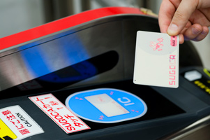
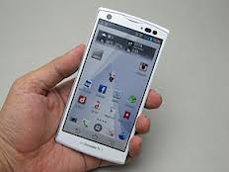
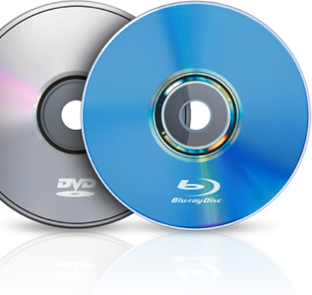
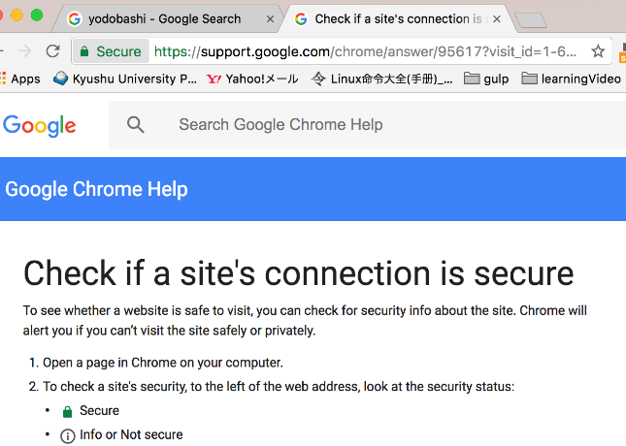
Information security in daily life
Cryptography and information security are used everywhere every day.
IC Card
Smart Phone
Blu-ray / DVD
Online shopping

Slide 6
What is the information security
Maintain confidentiality, integrity and availability of information
Three major elements of information security
Confidentiality
Not only to ensure those who are authorized to access information ,but also to ensure that the information can be accessed
Integrity
To ensure that the information is not destroyed, altered or erased
Availability
Ensure that persons who are permitted access to information have access to information and related assets without interruption when necessary

Slide 7




4 Major threats （1/4）
Eavesdropping
Confidentiality of information is not protected

Slide 8

4 Major threats（2/4）
Spoofing
Confidentiality of information is not protected

Slide 9
4 Major threats（3/4）
Tampering
1 million yen
10,000 yen
Integrity of information is not protected

Slide 10
4 Major threats（4/4）
Denial
I ordered it a week ago ,all right?
No, I did not order it. Do you have evidence?

Slide 11
Role of encryption
Using cryptographic algorithms and cryptographic protocols to realize confidentiality ,integrity ,etc. against the four major threats
Research on the composition method, performance and safety of cryptosystem

Slide 12
The history of cryptography
From ancient cryptography to modern cryptography

Slide 13
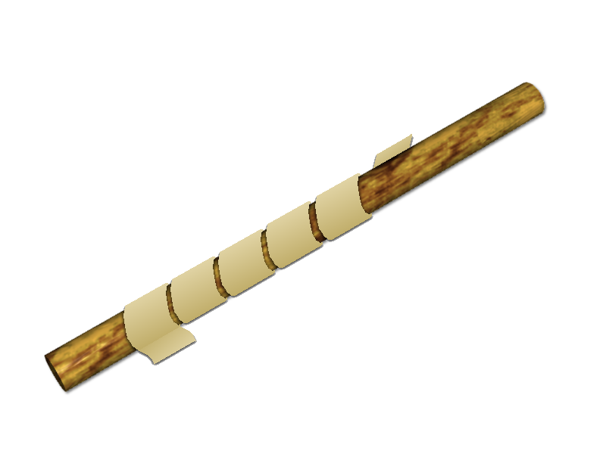
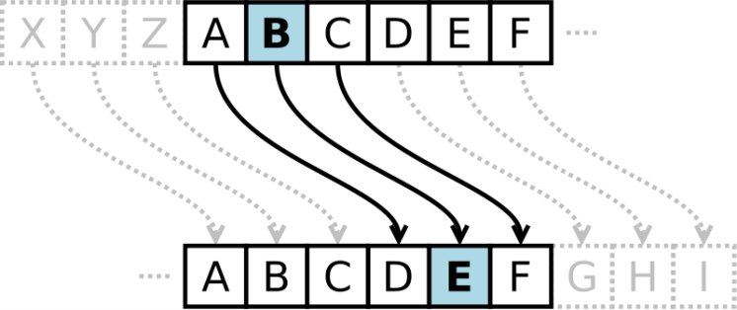
Ancient cryptography
There was encryption from BC.
  Scytale encryption
    Used in Sparta in the 5th century BC
    Wrap a string of stringed ribbon around a bar
    Meaningful sentences appear in a certain column
  Caesar cipher
    Caesar used it for personal communication (not military) in the 1st century BC
    Encrypt by shifting each character at even intervals
    Decoding is shifted to the opposite side

Slide 14
Caesar cipher (an example)
H | E | L | L | O |  | W | O | R | L | D
Shifting 13
U | R | Y | Y | B |  | J | B | E | Y | Q
ABCDEFGHIJKLMNOPQRSTUVWXYZ
||||||||||||||||||||||||||
NOPQRSTUVWXYZABCDEFGHIJKLM

Slide 15
From ancient to modern
Cryptography developed gradually before modern times
  Scientists disclose codetext by Anagram, to insist on what he was discovering while concealing his discovery
  Request the safety of the cipher from the need of diplomatic and military
Cryptography rapidly develops from modern to modern times
  In 1895 Realization of wireless communication by Morse code
    Anyone can intercept → cryptographic technology is essential
  In 1918 Invention of mechanical encryption device "Enigma"
    In 1925 German Army officially adopted
    In 1939 British cryptographers Alan Turing etc. to decrypt
  In 1940 Emergence of computer
  From 1990 Diffusion of the Internet
Notes:
Imitation game (2014) Camber batch

Slide 16
Technology used in modern cryptography

Slide 17
Safety of modern cryptography
Kerckhoffs' principle
Even if an enemy (attacker) knows information other than the secret key, it must still be safe
Information other than the secret key is encryption algorithm, decryption algorithm, etc.
Kerckhoffs' principle is the basic requirement of modern cryptography
If the algorithm is published, there is an advantage that it is possible to examine cryptographic security between researchers and standardize it

Slide 18
Types of safety
Information theoretic safety (Absolute safety)
  Safety guaranteed to attackers with infinite computing power
  One time pad cipher has this safety
    Encryption using a random number table to be disposable at one time
Computational safety
  Safety in the sense that enormous time is required for attack calculation and realistically impossible
  The safety of many common key cryptography, public key cryptography is based on this
Physical safety
  Safety guaranteed based on certain physical principles
  E.g.：Quantum cryptography
    Using the uncertainty principle to use a line that shares information by sender and receiver
    It is impossible to measure the quantum state of an object without leaving traces

Slide 19
One time pad cipher
Although it is safe in information theory, since it uses a key of enormous size, it is inappropriate as a cipher which is usually used
One time pad example
  The Japanese Army during the Pacific War
  After avoiding the Cuban crisis (1962), the two countries, which keenly felt the necessity of a communication line where the US-Leaders directly dialogue, established a communication line (hot line) called "red telephone" on August 30, 1963.One time pad cipher was used.
    Character communication rather than voice while referred to as the "phone"

Slide 20
Numerous cryptographic technologies

Slide 21

Model of confidential communication
Use two kinds of "key"
Regular message
Cryptographic key
Decryption key
Ciphertext
Plaintext
Plaintext
encryption
Decryption
NETWORK

Slide 22
Common key cryptography
Cryptosystems used before modern times
Features
  Sharing a key between the sender and receiver
  Processing is fast, still important
  Typical examples : AES, DES
  Means to securely share
  keys are required separately
Encryption key=Decryption key
Ciphertext
②Transmission
Ciphertext
①Encrypted
with Encryption
key
③Decrypt
with
decryption
key
plaintext
plaintext
sender
receiver
Confidential communication
Notes:
AES encryption is a common key encryption method standardized as a new encryption standard (Advanced Encryption Standard) in the United States of America. Since the encryption standard DES (Data Encryption Standard) issued in 1977 became obsolete due to technological progress, we made a public offering of a new cryptosystem, publicly announced as FIPS PUB 197 in March 2001, and the network concealed by the US military It was adopted as Tor, etc. which is an open source project.

Slide 23
Block cipher & Stream cipher
Block cipher
  A method of dividing plaintext into blocks of fixed size and encrypting each block
    Block size is commonly 64bit or 128bit
  Encryption mode ：ECB mode , CBC mode etc.
    ECB: Electric Code Book
    CBC: Cipher Block Chaining
Stream cipher
  To encrypt plaintext by bit or byte etc. successively
  Normally, encryption is performed while configuring the key stream

Slide 24
Public key cryptography
In modern day, public key cryptography is indispensable
Features
  It is different from the encryption
  key and the decryption key
  There is no need to send the
  key in advance
    Fixed shortcomings of common
    key cryptography
  Anyone can create ciphertext but
  can not decrypt without secret key
  E.g.：
  RSA , Elliptic curve cryptography
Publish as public key
Encryption key≠ Decryption key
Ciphertext
②Transmission
Ciphertext
①Encrypted
with Encryption
key
③Decrypt
with
decryption
key
plaintext
plaintext
Important
sender
receiver
Keep as secret key

Slide 25
Public key cryptography
How do we realize a pair of public key / private key?
In constructing the key, an essential condition
  A corresponding secret key can not be inferred from the public key
  A document encrypted with a public key can be decrypted only with its corresponding secret key
Secret
Public
One-way function
Public
Another one-way function
Plaintext
Ciphertext
  Requires trapdoor
TRAPDOOR
Secret
Notes:
In that public key cryptosystem, [read]
.....
[until the end]
If the sparse condition is not satisfied, the cryptographic method becomes unsafe and we can not ensure that information is protected from eavesdropping.

Slide 26
RSA encryption & El Gamal encryption
RSA encryption
  Currently, the most popular public key cryptography
  In 1977 , invented
  Inventors Ron Rivest, Adi Shamir, Len Adleman
  Safety is based on “difficulty of factoring factorization”
El Gamal encryption
  "Elliptic curve cryptography" primarily refers to elliptical El Gamal cryptography (or its subspecies).
  It is applied to copyright protection technology, pairing encryption, etc.
  Safety is based on “difficulty in deciphering the discrete logarithm problem”

Slide 27
Common key cryptography vs
Public key cryptography
 | Merit | Demerit
Public key | Since we are disclosing the key, we do not need to share it | Processing is slow
Common key | Processing is fast | We must share keys in advance

Slide 28

Hybrid system
Combine the metric of common key cryptography and public key cryptography
①Public key method
Key for common key method
Alice
Bob
②Common key method

Slide 29


Digital signature (electronic signature)
Technology for executing acts of signature or imprint on paper medium on electronic
Apply the technology Public key cryptography.
With paper media
With electronic media
It is effective as a certificate
by signature / imprint
The document is just data.
Easy copying and tampering.
Signature technology not forged on electronic is required.
Contract
contract
Can be realized by public
key encryption technology
HUKUZAWA
HUKUZAWA
Attach a signature /
seal of another document
Easy to forge

Slide 30
Signature by public key cryptography
In some public key cryptosystems such as RSA, public and private keys can be used in reverse for encryption/decryption.
  In the case of cryptographic communication, it is encrypted with a public key and decrypted with a secret key
  In the case of a signature, it is encrypted (signed) with a secret key and decrypted with a public key (signature verification)
If you have the public key, you can confirm that the signed data is the thing of the principal
  Only those who have the corresponding secret key can be given a correct signature (to prevent spoofing and denial)
Whether or not the public key is genuine is a problem
  There is a mechanism that "Certification Authority" separately signs and certifies

Slide 31
Hash function
A function that returns "fixed length data" from "arbitrary length data”
There are several uses
  Prevent tampering with data (message authentication code (MAC) etc.)
  Digital signature, various authentication, data error check etc.
Document B（ Tampering with document A ）
Document A
Different (long) documents
1 | 0 | 1 | 1 | … | 1 | 1 | 0 | 1
1 | 0 | 1 | 1 | … | 1 | 1 | 1 | 1
Hash function
Hash function
1 | 0 | … | 1 | 0
0 | 0 | … | 0 | 1
It is known that it has been tampered with because of different hash value
Digest A
Digest B

Slide 32
(Principal) authentication
Verifier
Technology to prevent spoofing
There are several
authentication methods
  Asking for knowledge
    Password
  Possession
    Passport, Driver's license,
    Hardware token
  Biometrics
    Fingerprint, vein, glow, handwriting
    Using a digital signature
Is he really Mr. A? Can you solve this problem?
problem ………………………………
…………………….
(Mathematical problem which A can solve only)
Mr. C's spoofing
What should I do. I'm not A, so I can not solve it.
Authentication by digital signature
Primary Course of Cyber Security

Slide 33
Application example of cryptography in real world
TLS (Transport Layer Security)
  Security protocol to enhance the transport layer
  Required for online shopping, online banking, secure use of e-mail
  The foundation of HTTPS
Encryption of hard disk etc.
  BitLocker , FileVault etc.
  Many are using AES
    Recent equipment is also loaded with high-speed processing chip of AES
Primary Course of Cyber Security

Slide 34
SSL・TLS
Mechanism (protocol) that encrypts communication on the Internet and makes it secure
  SSL: Secure Socket Layer
  TLS: Transport Layer Security
  It can be thought that SSL and TLS refer to almost the same thing.
It can not be used unless both server and client are compatible.
  E-mails and webs have almost no problem
Including a mechanism to check whether the server is genuine
Primary Course of Cyber Security

Slide 35
TLS protocol (outline)
Customer (client)
Store (server)
ClientHello{Ra, CipherList}
Generate random number Ra
Generate random number Rb
ServerHello{Rb, Cipher}
Receive server certificate (public key Ks)
ServerCertificate{Ks, Server cert.}
Ks
CertificateRequest, ServerHelloDone
Secret key Kp
Pre master secret Rc generation
Decrypt with Kp and get Rc
ClientKeyExchange
{Rc encrypted with Ks}
Public key cryptography
Ksh
Ksh
Create master key Ksh from Ra Rb Rc
Create master key Ksh from Ra Rb Rc
[ChangeCipherSpec]
Finished{hashed handshake msgs}
Hash function
[ChangeCipherSpec]
Finished{hashed handshake msgs}
Common key cryptography
Data encrypted with Ksh
35

Slide 36
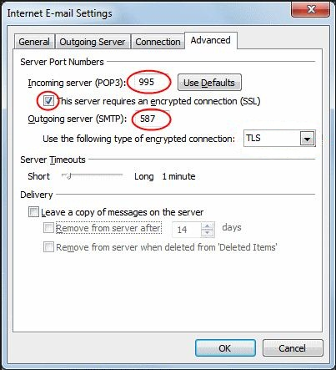
Encryption of sending and receiving mail
（Outlook 2013）
For details, please see http://www.m.kyushu-u.ac.jp/s/4-PC.html
Primary Course of Cyber Security
Notes:
Since the password is not encrypted in the mechanism of the mail itself, it is necessary to protect the whole communication with SSL / TLS Depending on the service, it may be possible to connect with or without encryption, so please make sure that you use it with encryption

Slide 37
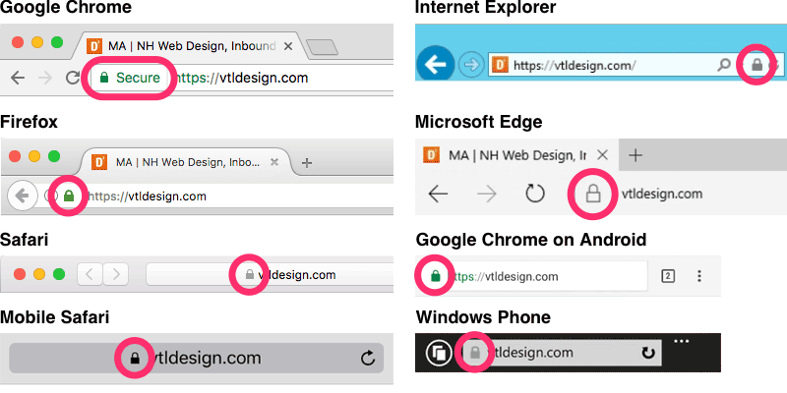
Web encryption (https)
Primary Course of Cyber Security
Notes:
The display location differs depending on the browser, but when connecting with https, a padlock mark appears at the address
Clicking on it will display detailed information

Slide 38
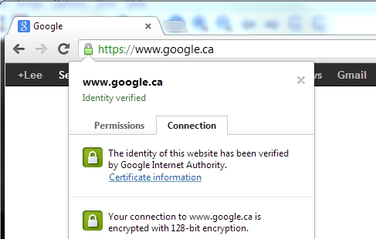
Web encryption
（Google Chrome）
Primary Course of Cyber Security

Slide 39
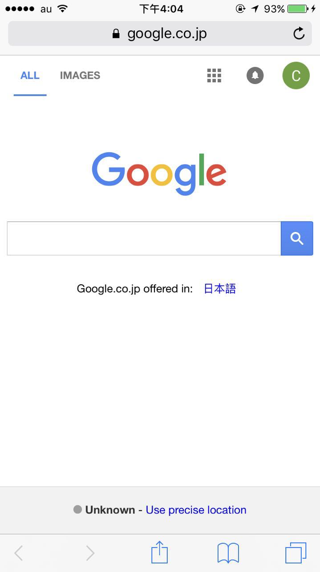
Web encryption
（iPhone Safari）
Primary Course of Cyber Security

Slide 40
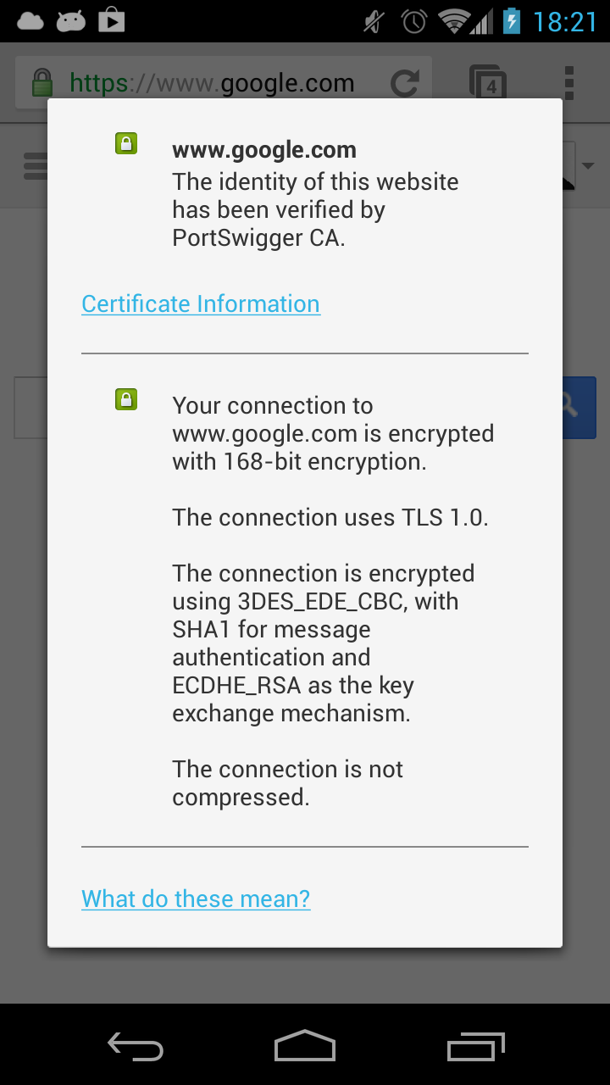
Web encryption
（Android Chrome）
Primary Course of Cyber Security

Slide 41
Applications？
It is not easy to understand at first glance
  Many things on the back communicating with the web
    Login processing etc. should be using https
Whether truly encrypted or not is not known unless you look through the communication
  Applications that do not validate the other server correctly
  Server validation?
Primary Course of Cyber Security

Slide 42
Server certificate
Have it issued from the "certificate authority" and put in the server
  A public key of the server is signed with a secret key of "certificate authority"
Connect to https://www.kyushu-u.ac.jp/
A certificate is returned from the server
  Generally ,certificate is issued to 「www.kyushu-u.ac.jp」 .
Verify the signature of "Certification Authority" and confirm it is genuine
  If the certificate issued by the certificate authority that the browser knows (has the public key) is ○, a warning is displayed.
If the name of the connected server matches the name of the certificate ○, a warning is displayed.
  Even if the certificate has a deadline and it's expired
Primary Course of Cyber Security

Slide 43
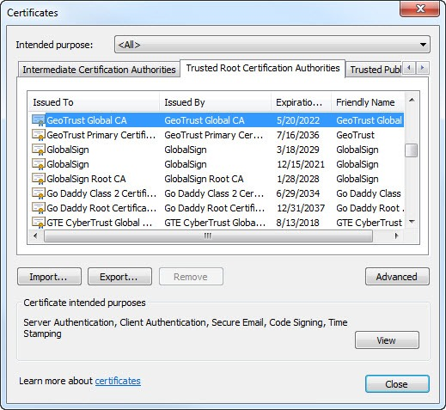
Trusted certificate authority
Primary Course of Cyber Security

Slide 44
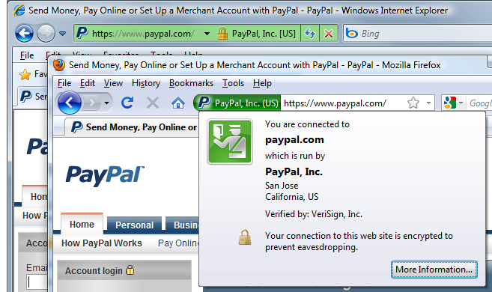
Extended Validation Certificate
Certificate that passed an examination meeting certain criteria
  The address bar turns green
Primary Course of Cyber Security

Slide 45
Counterfeit of certificate?
"Trusted Certification Authority" investigates the identity of the server when issuing a certificate.
  A person elsewhere can not issue a certificate with the name of www.kyushu-u.ac.jp
  It is signed with the private key of "trusted certificate authority" and can not be forged
It is possible to create a certificate arbitrarily, but you can see that it is not issued from a "trusted certificate authority"
  There is also an attack that puts a fake certificate authority in ‘trusted certificate authority’
Since the certificate is a public key, it can not be used on the server unless there is a secret key to be paired
Primary Course of Cyber Security

Slide 46
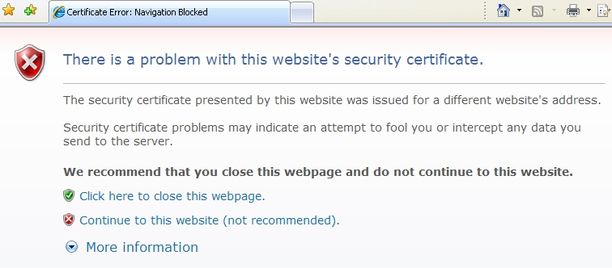
Warning screen
（Internet Explorer）
Primary Course of Cyber Security
Notes:
Forgery of server certificates is difficult, so fake servers often send fake certificates
In that case such a display appears if it can detect that it is fake
It is difficult to make similar warnings even if the setting of the server is incorrect or the certificate has expired
Or you have to use the certificate that you can not check whether it is genuine or stingy for money to buy a server certificate
In the recent example there was a case that Bangladesh's online visa issuing site used certificates that were invalid
That's not very good if you get accustomed to choosing to "continue"

