Slide 1
Introduction to Cyber Security
― To survive in the IT society ―
Learn about the law

Slide 2
Learn about the law
Basic Act on Cybersecurity of Japan
Penal Code
Act on Prohibition of Unauthorized Computer Access
Act on Optimization of Transmission of Constant Electronic Mail
Radio law
Act on the Protection of Personal Information
Cloud use and foreign law
Regulations on security at Kyushu University etc.

Slide 3


Major source of today's lecture
http://ja.wikipedia.org
http://www.ipa.go.jp

Slide 4
Basic Act on Cybersecurity of Japan
（Established November 6, 2014）
Law stipulating the responsibilities of the government concerning cyber attack countermeasures
(Responsibility of Educational Research Institution) Article 8 In accordance with the basic principles, universities and other educational and research organizations are to make an effort to ensure Cybersecurity voluntarily and proactively, develop human resources specialized for Cybersecurity, disseminate research and the results of research on Cybersecurity, and cooperate with measures taken by the national government or local governments..
(Citizen's efforts) Article 9 In accordance with the Basic Principles, the people are to make an effort to deepen their awareness and understanding of the critical value of Cybersecurity and pay necessary attention to ensuring Cybersecurity.
Full-text bill
  http://www.shugiin.go.jp/internet/itdb_gian.nsf/html/gian/honbun/houan/g18601035.htm

Slide 5
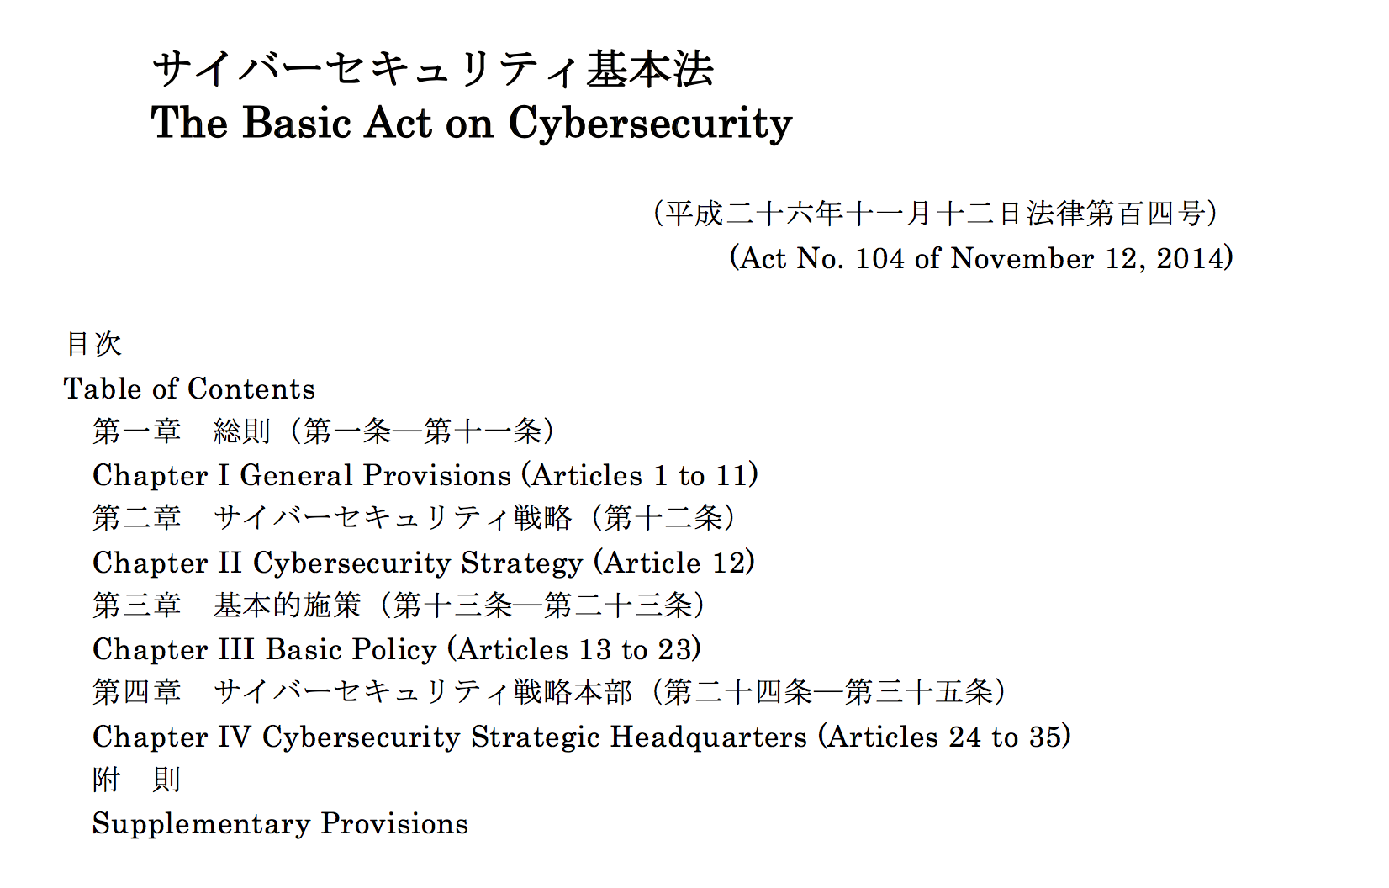
http://www.japaneselawtranslation.go.jp/law/detail/?ft=1&re=02&dn=1&x=0&y=0&co=01&ia=03&ky=セキュリティ&page=1

Slide 6
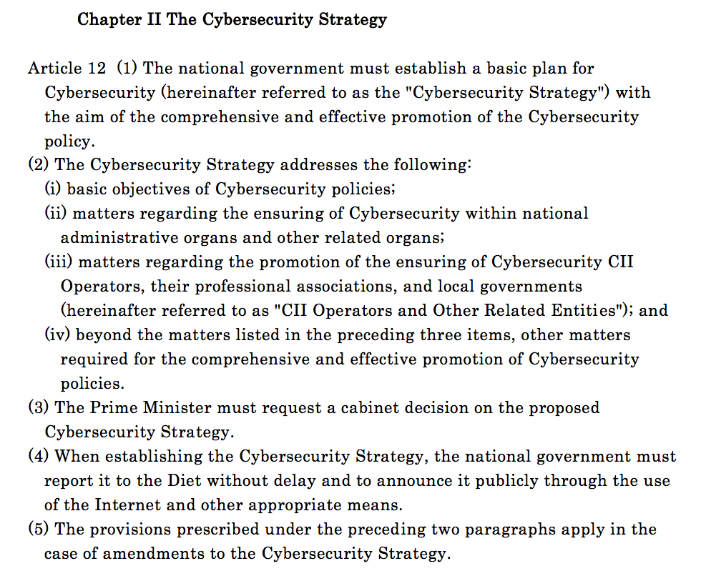
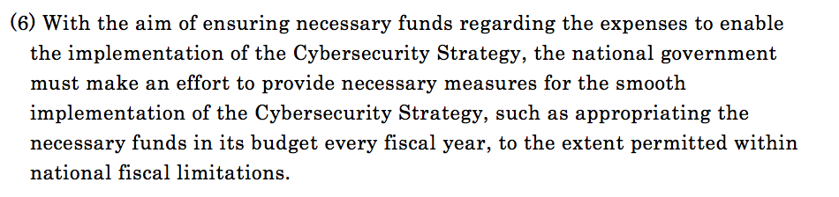

Slide 7
Penal Code （ Law number:Act No. 45 of 1907 ）
The Japanese general provisions about crime and individual crime establishment requirement and sets punishment against it.
It was promulgated on April 24, 1907, and it took effect on October 1, 1908.
To distinguish it from the "criminal law" in a broad sense, it is also called the penal code.
In Japan, it is one of the laws constituting the so-called six laws, and it is a basic law.
However, not all criminal laws are prescribed in the Penal Code, and there are also many crimes prescribed in the Criminal Special Law or the Special Penal Code.

Slide 8
Penal Code （ Law number:Act No. 45 of 1907）
Three laws to prevent computer crime were added in 1987 revision
  Electronic computer damage and other business crimes
  Illegal electromagnetic record creation and use
  Fraud crime by using computer
Criminal penalties are imposed on destruction and tampering of computers and data

Slide 9
Electronic computer damage and other business crimes
Destruction of computers used for business 、
Destruction of data for computers 、
Methods such as making false data and illegal execution to the computer
Acts that interfere with business
DoS Attack
Malicious programs and the illegal operation of data
Troublesome caused by site access with unsupported browser

Slide 10
Unauthorized Creation of Electromagnetic Records
Penal code article 161-2
http://www.japaneselawtranslation.go.jp/law/detail/?vm=04&re=02&id=1960&lvm=01
Cash fraud exploitation by counterfeiting / copying of cash cards (Tokyo Region 1, 2, 22, Tokyo Region 1, 2, 17)
Tamagotte balloting and tampering of Katsuma ballot tickets(Kofu area judgment Heisei 1.3.31)
Tampering frequency can be used by telephone cards (Nagoya local magistrate judgment on April 22)
Etc.

Slide 11
Computer Fraud
Article 246-2
http://www.japaneselawtranslation.go.jp/law/detail/?vm=04&re=02&id=1960&lvm=01
A person who obtains or causes another to obtain a profit by creating a false electromagnetic record relating to acquisition, loss or alteration of property rights by inputting false data or giving unauthorized commands to a computer utilized for the business of another, or by putting a false electromagnetic record relating to acquisition, loss or alteration of property rights into use for the administration of the matters of another shall be punished by imprisonment with work for not more than 10 years.
Fraud to obtain a gain by rewriting the electromagnetic record
  Acts to transfer the CD card of another person you pick up to your account using ATM （ Previously, there was no provision to punish when using for transfer ）
  Unauthorized use of prepaid card such as commuter pass
The act of taking out cash from the ATM using the stolen cash card of another person is a thief

Slide 12
Act on Prohibition of Unauthorized Computer Access
Law number : Act No. 128 of 1999
https://www.npa.go.jp/cyber/legislation/pdf/1_kaisetsu.pdf
Sound development of advanced information and communication society
Prevention of cyber crime · Maintenance of order on telecommunications
Penalty to the actor
prohibiting acts of unauthorized computer access and stipulating penalties
Protective Measures
Protective Measures by an Access Administrator
Administrator's defensive measures
prohibited for any person to engage in an Act of Unauthorized Computer Access.
Prohibition of Acts of Obtaining Someone Else's Identification Code
Assistance, etc. by Prefectural Public Safety Commissions
Prohibition of Acts of Facilitating Unauthorized Computer Access
Administration assistance
National Public Safety Commission, Minister for Internal Affairs and Telecommunications, and Minister of Economy, Trade and Industry must endeavor to supply of the necessary information and so on, provided that they are deemed to be capable of providing such assistance appropriately and effectively.
Prohibition of Acts of Wrongfully Storing Someone Else's Identification Code
Prohibition of Acts of Illicitly Requesting the Input of Identification Codes

Slide 13
Act on Prohibition of Unauthorized Computer Access
Prohibition and punishment of Acts of Illicitly Requesting of Identification Codes
  It is prohibited for any person to obtain someone else's identification code associated with an Access Control Feature for the purpose of engaging in an Act of Unauthorized Computer Access （ Article 4 ）。
  Violators are sentenced to imprisonment with work for not more than one year or a fine of not more than 500,000 yen (Article 12 (1))
  Newly banned in Heisei 24 revision.
Prohibition and punishment of Acts of Facilitating Unauthorized Computer Access
  It is prohibited for any person, unless there are justifiable grounds for refusing to do so or any other legitimate reason therefor, to supply someone else's identification code associated with an Access Control Feature to a person other than the Access Administrator associated with the Access Control Feature concerned and the Authorized User to whom the identification code concerned belongs. Violators are sentenced to imprisonment with work for not more than one year or a fine of not more than 500,000 yen (Article 12 (2)).
  In the revision of Heisei 24, the act of providing an identification code which is unclear as to which particular electronic computer is involved in specific use has also been prohibited newly.
Prohibition and punishment of Acts of Wrongfully Storing Someone Else's Identification Code
  It is prohibited for any person to store someone else's identification code associated with an Access Control Feature that has been wrongfully obtained for the purpose of engaging in an Act of Unauthorized Computer Access （ Article 6 ）。 Violators are sentenced to imprisonment with work for not more than 1 year or a fine of not more than 500,000 yen (Article 12 (3)) .
  Newly banned in Heisei 24 revision .

Slide 14
Act on Prohibition of Unauthorized Computer Access
Prohibition and punishment of Acts of Illicitly Requesting the Input of Identification Codes
（ Revision in Heisei 24 ）
  Phishing activities by phishing site construction (Article 7, No. 1) and e-mail transmission (Article 7.2) are prohibited. Violators are sentenced to imprisonment with work for not more than 1 year or a fine of not more than 500,000 yen (Article 12 (4)).
Protective Measures by an Access Administrator
  The access manager has an obligation to make the following measures (Article 8). There is no penalty.
    1. Appropriate management of identification code etc.
    2. Verification and advancement of access control function
    3. Measures necessary for defending against other unauthorized access actions

Slide 15
Act on Optimization of Transmission of Constant Electronic Mail
http://www.soumu.go.jp/main_sosiki/joho_tsusin/security/basic/legal/08.html
A law stipulating provisions on the sending of e-mail for the purpose of advertisement, promotion or solicitation without the consent of the user
Restrict transmission of specific e-mails
  Beside the person who has a business relationship with a person engaged in sales activities relating to advertisement ,the person whose permission is gotten can be receive the e-mail（ Enacted on 1 December 2008 ）
Obligation of Labeling
  Name, name, mail address etc. of the sender
Prohibition of Transmission under False Sender Information
  Use fake e-mail address for sending
  Use fake telecommunication equipment identification letters, numbers for transmission
Prohibition of Transmission Using Fictitious Electronic Mail Address

Slide 16
Act on Optimization of Transmission of Constant Electronic Mail
http://www.soumu.go.jp/main_sosiki/joho_tsusin/security/basic/legal/08.html
The main items are listed below. In addition, due to the revision of the 2008 Law, the penalty for corporations for some violations has been significantly increased.
  A prison sentence of 1 year or less or a fine of 1 million yen or less (corporation is a fine of 30 million yen or less)
    When falsifying sender information (Article 34 (1))
    In the case of violation of a measure order under the provisions of Article 7 (excluding those concerning preservation of record such as consent of recipients) (Article 2 of said Article)
  Fines of 1 million yen or less
    In case of violating the order of action under the provisions of Article 7 (limited to those concerning preservation of records such as consent of recipients) (Article 35 (1))
    Refusal of inspection based on the provision of Article 28 (1), or when making a false report (Article 2)

Slide 17
Radio law（ Law No. 131 of May 2, 1945 ）
http://law.e-gov.go.jp/htmldata/S25/S25HO131.html
Purpose of ensuring fair and efficient use of radio waves (electromagnetic waves of 3 MHz MHz or less)
Convention on radio waves
Establishment of wireless station
  License of Minister of Internal Affairs and Communications
Designation of calling code or calling name
Reason for disqualification
Application for license, preliminary license, license letter, registration renewal etc.
Penal Provisions (Chapter 9)
Weak radio waves (26.9 MHz to 27.2 MHz, 0.5 W or less) are not specified
Article 106 A person who has issued false communications by radio equipment or communication facilities set forth in paragraph (1), item 1 of Article 100 for the purpose of giving profits to self or other persons or damaging others, shall not exceed three years punishment or impose a fine of 1,500,000 yen or less.

Slide 18
Act on the Protection of Personal Information
(Abbreviation) Personal Information Protection Act
2003 (Heisei 15 years) was established on May 23rd
http://law.e-gov.go.jp/htmldata/H15/H15HO057.html
Article 1 ：Purpose
  Obligations to be observed by business operators dealing with personal information, such as basic philosophy, basic policies, responsibilities of national and local governments, protection of personal rights and interests.
Article 2
  Personal information: Information on surviving individuals. Those which can identify individuals by name, date of birth, or other descriptions
  Personal information database , personal information handling business operator, personal data etc.
Article 15～36 Obligation of business operator handling personal information
  Restriction on proper use (diversion, trading, assignment, etc.) by purpose of use (diversion, trading, assignment etc), notification of proper use, securing of accuracy, safety control measures, restriction on third party provision, disclosure
Article 2, paragraph 3, item 5 of the Act (exceptional provisions for the people whose businesses is handling personal information)
The total number of specific individuals identified by personal information is not exceed 5000 on any day within the past six months

Slide 19

Cloud use and foreign law
(From Ministry of Economy, Trade and Industry)
http://www.publicpolicy.telefonica.com/blogs/blog/2011/05/19/cloud-computing-isn%E2%80%99t-just-a-buzzword-2/
Sometimes you do not know the physical storage location of the data
  For services provided by overseas large-scale cloud providers 、
  There are cases where it is not possible to specify in which country the data stored
  In consideration of regulatory constraints (to be described later) and the effectiveness of justice, it is also necessary to select a business entity that promises to save on a domestic server.
USA Patriot Act
  Regarding the simultaneous multiple terrorist attacks that occurred on 11th September 2001, expanding authority of the investigation institution, prevention of international money laundering, border security, immigration control, relief to victims of terrorism Regarding the simultaneous multiple terrorist attacks that occurred on 11th September 2001, expanding authority of the investigation institution, prevention of international money laundering, border security, immigration control, relief to victims of terrorism
  Specify authority to intercept wired communication and electronic communication related to terrorism, computer fraud and crime of computer abuse
  If the investigation institution obtains the consent of financial institutions and providers, it regulates that operations can be conducted without seeking court involvement
    When saving data to the US server, it is necessary to pay attention that the authority of the agency's investigation is large
    In the case of using the cloud service, there are cases where even a virtually separated environment shares the same server equipment physically the same as other users, so when other users are investigated, the company There is also a risk of being affected by system shutdown etc.

Slide 20

Regulations on security at Kyushu University
Kyushu University Security Policy
Kyushu University Information Ethics Policy
Corporation compliance
  One of the basic principles of corporate governance .The company acts according to very basic rules such as laws and internal rules ． Sometimes referred to as business compliance.
  "Compliance" is a term meaning "obedience", which is not limited to "companies comply with the law", but here it is used in the sense of "compliance with laws and regulations" ．There are opinions that include "social norms, corporate ethics" ．
  Company = Kyushu University
Frequent scandals such as impersonation display of foods, unfair accounting, improper bidding, covering of complaints, eavesdropping cases etc.
http://dictionary.sanseido-publ.co.jp/topic/10minnw/003compliance.html

