Slide 1
Introduction to Cyber Security
― To survive in IT society ―
Copyright

Slide 2
Copyright
Points to keep in mind for copy of copyrighted materials such as online contents
- Basic theory of cyber security “Copyright”-
※ This content is lecture material on "copyright" of cyber security basic theory. I am referring to the educational materials on the copyright of the Agency for Cultural Affairs. （ http://www.bunka.go.jp/seisaku/chosakuken/seidokaisetsu/pdf/h28_text.pdf ）
「Copyright」
  Background and purpose of lecture
  Procedures for using copyrighted material
  Works,authors,copyrights,copyright holders
  Example of usage without permission of creative work
  (Copyright law and related laws)

Slide 3
Background of「copyright」lecture
Use of existing materials (creative work) in report・publication preparation, teaching material development, etc.、Fixed things in reference
＝＞Base on copyright law
Diffusion of the Internet like World Wide Web etc.
Existence of countless digital contents (digitized material) on the Internet (cyber space)
Easy to duplicate digital contents
Attention is required in the use, reference, and disclosure of digital contents in cyber space

Slide 4
Purpose of lecture「Copyright」（Legal）
Understand the procedure to use creative work
Understand creative works and other things
Recognize that it is necessary to obtain the approval of the author (authority) to use the creative work
Understand the scope of unnecessary use for author's consent
References: Teaching Material of Agency for Cultural Affairs, Copyright Section
- Scene-oriented guidance example collection "How to use 5 minutes of copyright education" -

Slide 5
Purpose of lecture「copyright」 (ethical)
Make a distinction between my work and another's work
Recognizing that it is a rule of society to obtain consent of the author (authority) in using other person's work
Even those that do not need to obtain consent from the author (author) , should to recognize the value of the creative work
Pay tribute to the author of the creative work
Think about what you think when your own work is used without permission
References: Teaching Material of Agency for Cultural Affairs, Copyright section
- Scene-oriented guidance example collection "How to use 5 minutes of copyright education" -

Slide 6
Procedures for using copyrighted material
Obtaining materials (digital contents etc.)
Is it a creative work?
· Article 2, Paragraph 1, Item 1 of the Copyright law
NO
YES
NO
Is it within the protection period?（The principle of the protection period is 50 years after the author's death, but there are exceptions）
Exception of protection period：http://copyright.watson.jp/others_exception.shtml
YES
YES
Is it possible to use it without the understanding of the copyright owner?
NO
YES
Find the copyright holder and obtain permission for use(Sometimes you can get permission from copyright management organizations)
NO
Pay for consideration
Use

Slide 7

Works, authors, copyrights, copyright holders
creative work＝ is defined as「It is a creative expression of thought or feeling、belonging to literature, academic, artistic or the scope of music」
（Article 2 Paragraph 1 item 1）
lyric
Tanka
Haiku
novel
scenario
paper
Songs
lyrics
Photo
Design drawing
map
Children's works are
also creative works
Computer
program
movie
dababase
painting
Sculpture
Printmaking
news・
magazines
Video game
Expansion of concept

Slide 8
Not creative works
「Mere data」 is excluded from creative work, by thinking of 「thought or feeling」
By thinking of 「creative」, 「counterfeit goods」 of others‘ work and 「commonplace」 contents are excluded
「Ideas」 are excluded by thinking of 「expressions」. Beside, sentences etc. describing 「ideas」 are included in creative work
Depending on the conditions of 「belonging to literature, academic, art or music range 」、「Industrial products」 etc. are excluded from creative work
Reference link http://chosakuken.bunka.go.jp/naruhodo/outline/4.1.html

Slide 9
Not creative works
「Mere data」 is excluded from creative work, by thinking of 「thought or feeling」
Ex）
  Weather data
    Terms of Use of Japan Meteorological Agency Website
    http://www.jma.go.jp/jma/kishou/info/coment.html
  Geographic data
    Terms of use of Geographical Survey Institute contents
    http://www.gsi.go.jp/kikakuchousei/kikakuchousei40182.html
  Graduation roster (violation of personal information protection law when publishing without permission)

Slide 10
Not creative works
By thinking of 「creative」, 「counterfeit goods」 of others‘ work and 「commonplace」 contents are excluded
Things that become the same no matter who expresses it, is considered to be no creativity.
Ex）
  Pictures replicating TV animation and cartoon characters
  Photos taken from the front of paintings
  （Publish without permission infringes the copyright of characters and paintings）

Slide 11
Not creative works
「Ideas」 are excluded by thinking of 「expressions」. Beside, sentences etc. describing 「ideas」 are included in creative work
Even with the same idea, if there is creativity in the way of expression it becomes a creative work
Ex）
  Actually real magic tricks are used in criminal drama’s crime＝＞Drama is a creative work

Slide 12
Not creative works
Depending on the conditions of 「belonging to literature, academic, art or music range 」、「Industrial products」 etc. are excluded from creative work
Industrial products have designs (shape and color, mass production and movability ) registered.

Slide 13

Works, authors, copyrights, copyright holders
Copyright authors＝A person who created creative work
Rights (author's moral rights, copyright (property rights)) arise at the same time as the creation of the work [non-formalism]
Transfer of rights
Copyrights (property rights) can be transferred
Permission application
Publisher
Copyright holder = person who owns copyright

Slide 14
Works, authors, copyrights, copyright holders
Author
Copyright holder
Copyright
(property rights)
Author's moral rights
Right to copy
Right of presentation・ performance
Screening right
Public transmission right · Send permission right
Dictation
Exhibit right
Transfer right
Lending Rights
Distribution right
Translation right ·adaptation right
Right to use secondary works
Right to release
Right to display name
right to maintain integrity

Slide 15
Difference between author’s moral rights and copyright (property rights)
Author’s moral rights
１）Gist of rights
  Right to protect personal profit of authors
２）Transfer of rights
  It can not be relocated to anyone other than the author (individual exclusive)
３）Protection period
  If the author dies, it disappears (but it must be respected even after death)
Copyright（Property rights）
１）Gist of rights
  Right to protect the economic interests of authors
２）Transfer of rights
  As well as general property you can transfer to other people
３）Protection period
  In principle, it shall be kept for 50 years after author’s death (with exceptional provision)

Slide 16
Contents of author's moral rights
Right to release
  The right to decide 「Publish・Not to publish」
Right to display name
  Right to decide 「display name・not to display name」
  (Including selection of 「real name 」 or 「pen name (pseudonym)」)
Right to maintain integrity
  Right of creative works can not be altered without author’s will

Slide 17
Contents of copyright (property right)
① Right to create copies
② Right to distribute copies
③ Right to communicate without using copy
④ Right to process (translate, arrange, transform, adapt)
Note) The gist of the above-mentioned right ○○ means that the right holder has「the right not to be ○○ without permission」 ⇒ Right to prohibit another person's "act of ○○ without permission"

Slide 18
Contents of copyright (property right)
① Right to create copies
・Right to copy (all creative works)
Note）「Copies」 means、beside general 「copy」、include 「Recording」, 「photography」, 「copy with hand」, 「installing on a hard disk of a personal computer」, etc.
② Right to distribute copies
・Transfer right (other than 「movie work」)
・Lending right(other than 「movie work」)
・Distribution right(only 「movie work」)
Note）「Distribution」＝「Transfer」＋「Lending」

Slide 19
Contents of copyright (property right)
③ Right to communicate without using copy
・Right of presentation（「creative work of language」「creative work of dance・silence play」）
・Right of performance（「creative work of music」）
・Screening right（All creative works）
・Public transmission right · Send permission right（All creative works）
Note）「Public transmission」＝＞「Broadcasting」、「Cable broadcasting」、「Internet transmission」 and 「Fax transmission performed according to requests from the public」
・Dictation（「creative work of language」）
・Exhibit right（「creative work of arts」 and unpublished original work of 「creative work of photography」）

Slide 20
Contents of copyright (property right)
④ Right to process (translate, arrange, transform, adapt)
・Creativity of secondary works（All creative work）
・Right to use secondary works（Same as aboce）
Creative work
Secondary work
translate
publish
Original work
Translated original work
Translated book
Creativity of secondary works
Right to use secondary works

Slide 21
What is protection period of copyright?
Intellectual property right
Copyright
  Author’s right
    Protect creative work (From creation to 50 years after the death of the author)
  Neighboring rights
    Protect demonstration etc. (50 years since demonstration.)
Industrial property rights
  Patent right
  Utility model right
  Etc.
others

Slide 22
Use creative work without understanding of the copyright owner
Copy for 「private use」（Article３０）
Copy for 「quotation」（Article３２）
Copy at「Educational institute」（Article３５, Paragrap１）
Transmission by 「educational institution」 (Article35, paragraph 2)
Copying and sending as 「exam questions」 (Article36)
「non-profit・free」 presentation etc.（Article３８ paragraph１）
When the copyright owner 「accepting unauthorized use」

Slide 23
Use creative work without understanding of the copyright owner（１）
Copy for 「private use」（Article３０）
  Within a limited range such as personally or within home，for purpose other than work，there is exception rule when copying by the principal to use（When related to work，subsequent exception rules may also apply）
（Concrete example）
  When dubbing to enjoy TV drama etc. for oneself
  When saving images etc. found on the Internet to a personal computer for enjoying themselves

Slide 24
Use creative work without understanding of the copyright owner（2）
Copy for 「quotation」（Article３２）
  Exception rule when 「cite」 the work of others in publication materials and reports
（Concrete example）
  When the teacher makes a presentation material of the research meeting，as a material to explain the results of teaching guidance，「citing」 a passage of reading impression sentence of the guiding teacher and using it
  When children explain their own idea after learn about history，「cite」 a part of sentences of the museum’s homepage，to reinforce their own thoughts
  When students of arts, create slide of presentation，cite some works for explanation on expression techniques

Slide 25
Terms of use as 「citations」 (Summary)
A citation suitable for fair customary practice
（There is a reasonable master-slave relationship between his work and another's work）
（Cited parts should be clearly distinguished）
A citation within legitimate range for purpose
(There is inevitability of citation)
Citation from published works
※Even if it meets the above, in principle the source should be clearly indicated

Slide 26
Problems of exceptional provision under Article 32 (citation)
「You can use without permission if certain requirements are met」had been defined、but「requirements」are ambiguous
It is not perfect even if it complies with the requirements indicated by guidelines of the copyright owner organization such as publishers（Describe later）
There are cases where the requirement of 「citation」 contradicts 「easy to understand, ease of remembrance」

Slide 27
Problems of guidelines published by copyright owners' organizations such as publishers
STM「Permissions Guidelines」
～An agreement among publishers etc.・・・
From one article or book chapter in a magazine、up to 3 diagrams、and up to 5 diagrams from one book can be used without permission
Japanese Medical Paper Publishing Association 「About citation and Reprints」
About the manifestation of source
＜In the case of a magazine＞Author name, title, journal name, volume, issue, page, year of publication.
In principle、keep original shape (right to maintain integrity) and post it

Slide 28
About translation, adaptation (modification)
「Translation」 of the cited part
  It is available under Article 43 of the Copyright Law
「Adaption」 of the cited part
  It is not allowed to be used in Article 43.
    Consideration for right to maintain integrity (author's moral rights) which is the right for the creative work is not to be altered against author’s will
    Modifications to something to make it easy to understand and remembered is not allowed？

Slide 29
In light of the guidelines of copyright organizations such as publishers ...
  Kyushu University's 90-minute lecture material
  25 teaching materials of 6 universities：2018 slide
  Including others’ creative work：820(41%)
  「Inadequate description method of source」658(80% above)
Even trying to apply citations…
  「Conflict with 1 to 3 from 1 paper」1/4～1/3
  Massive use of images such as clinical practice guidelines
  There are many 「No title in the source」 and 「Alteration」
 | Number per lecture | Average±standard deviation
Slide | 27～173 | 87.5±34.9
Creative work by others | 0～73 | 22.8±16.2
Notes:
At present, there are 2018 slides included in 25 teaching materials collected from 6 universities that processed in the new process,
Among them, 820 pieces (41%) included copyrights of others.
The slide which corresponds to "method of describing source" is 80%.

Slide 30
Use creative work without understanding of the copyright owner（3）
Copy at 「Educational institute」（Article35, paragraph１）
  Default exception when teachers or children copy and distribute a part of another person's work to use as a teaching material
（Concrete example）
  When teachers，copy a part of a novel and distributing it to children, to use in lecture
  When children，copy newspaper article，distribute to other children, for 「investigate study」

Slide 31
Use creative work without understanding of the copyright owner（3）
Copy at「Educational institute」（Summary）
  Duplication in schools and other educational institutions (non-profit)
  Duplicate for use in course process
  Duplicate by homeroom teachers or students
  Duplication of scope recognized as necessary
  Duplication of published work
  In compliance with these requirements、duplication that does not unduly impair the interests of copyright holders

Slide 32
Use creative work without understanding of the copyright owner（4）
Transmission by 「educational institution」 (Article35, paragraph 2)
  Default exception when exchanging classes held at 「main venue」 to 「sub-venue」 at remote location Default（using others' work as a teaching material）at the same time
（Concrete example）
  When teacher sending 「teaching materials」 「map」 「chart」 etc. as teaching materials for the secondary venue，at main venue

Slide 33
Article35 Problems of exceptional provision (copying at school and other educational institutions)
It does not apply to on-line teaching materials
  For general e-learning、 on-demand distribution of recorded lectures and provision of teaching materials to learners by downloading materials、is clearly stated that it’s not applicable.
  Currently, it is interpreted that it’s not applicable even when access restriction is set by ID and password.

Slide 34
Use creative work without understanding of the copyright owner（5）
Copying and sending as 「exam questions」 (Article36)
  For testing or verification, there is exception when copying and distributing the entrance examination question using the work of others and when sending the exam question on the Internet etc.
（Concrete example）
  In the case of exam questions using novels, editorials, etc.
  In case of submitting test questions using novels, editorials etc. via the Internet etc.

Slide 35
Use creative work without understanding of the copyright owner（6）
「non-profit・free」 presentation etc.（Article３８ paragraph１）
  Default exception of stage performances · performances · dictation (recitation etc.) · screening when screening others' works in the curriculum, cultural festival, club activities etc.
（Concrete example）
  When the brass band plays or the theater department plays theater at cultural festival etc.

Slide 36





Use creative work without understanding of the copyright owner（7）
When the copyright owner is 「accepting unauthorized use」
（Concrete example）
  User license
    Creative・Commons・License
    ( http://creativecommons.jp/licenses/ )
    Freedom mark
    (http://www.bunka.go.jp/jiyuriyo )
display
Non-profit
Prohibited
modification
inheritance
Ok to copy
Disabled ok
School
education ok
Please be sure to check the following site when using

Slide 37
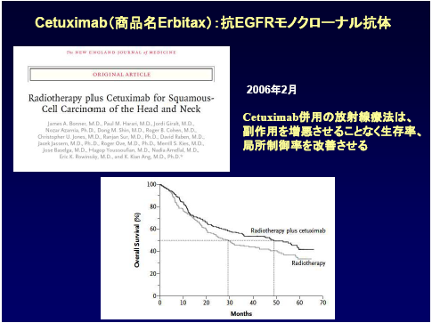
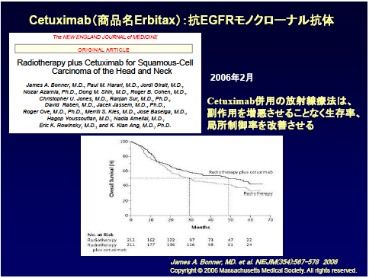
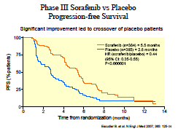
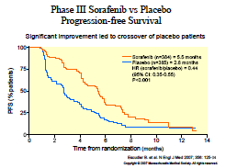
Example of license application
Before processing
After processing
Paste logo and title as image
Enter string manually
(Name Erbitax)
(Name Erbitax)
Radiation therapy in combination with Cetuximab,
Improve survival rate and local control rate without exacerbating side effects
Radiation therapy in combination with Cetuximab,
Improve survival rate and local control rate without exacerbating side effects
Delete part of graph data
Return to original
Publisher's instructions
Return to original
Change value of graph
Addition of description of copyright
Sources only

Slide 38
How to make online teaching materials including others' work (summary)
Create a slide according to requirements of 「citation」
  Clarification of source
    Base on guideline
  Translation
    It is legal if meets the requirement of 「citation」
  Adaptation (modification)
    Under consideration of author’s right to maintain integrity
Apply for licensing if it does not fall under 「citation」
    There is a possibility that translation , adaption is required to 「gain consent for reprinting before change, and application・approval after change 」

Slide 39
Comprehensive measures (educational institution ~ administration)
Train human resources with expert knowledge and skills
Enlightenment of faculty and staff (FD, SD)
Multicenter consultation on copyright processing policy
Create public guidelines (teaching material creator side)
Appeal to revise the law (Agency for Cultural Affairs, Copyright section)
Make a precedent that causes a legal conflict (!?)

Slide 40
About judicial precedents http://current.ndl.go.jp/node/31257
In 2008, 3 publishers of Oxford University Press, Cambridge University Press, SAGE Publications, with the support of the Association of America Publishers (AAP)、suit that Electronic reserves(E-reserves) that Georgia State University offers digit lesson materials to students had infringed copyright
On August 10, 2012, Judge Orinda Evans of the District Court for the Northern District of Georgia dismissed the plaintiff's injunction (that is, the plaintiff lost)
On September 10, 2012, three plaintiffs suited against the May 11 ruling by the federal district court
On April 25, 2013, the Library Copyright Alliance (LCA) submits a court advice to support Georgia State University
On October 17, 2014, at the 11th Circuit Court of Appeals of the US Federal Circuit, judged that universities are unfair to use copyright-protected materials without cost, returned the judgment of the district court
On November 6, 2014, the North American Research Library Association (ARL), regarding the electronic reserve case of the Georgia State University Library, published "Fair Use Decision Making Post-Georgia State" summarizing fair use idea
On March 31, 2016, the US District Court (Northern District , Georgia) indicated the reasons for the judgment on the lawsuit on Georgia State University's electronic reserve (E-Reserves).
  As the remand decision was made at the 11th Circuit Court of Appeals for the US Congress, investigated 48 copyright infringement sued by plaintiffs (Oxford University Press, Cambridge University Press, Sage) again, 41 cases are fair use permitted, only seven cases are permitted legal rights of plaintiff 's action.
※ Because the legal system is different in Japan and the United States, even 「there is such a ruling in the United States」、it is necessary to pay attention that 「It does not mean to be「the same in Japan」」.

Slide 41
Images should be noted in handling beside「copies of papers and textbooks」
Regarding the following images, handling such as correction, deletion or restriction of disclosure range is required.
Personal information (ex: patient diagnosis, facial photograph)
Landscape · People of education · research facilities etc.
Professional athlete, animated character etc.
Products that can not be published except for certain types of jobs

Slide 42
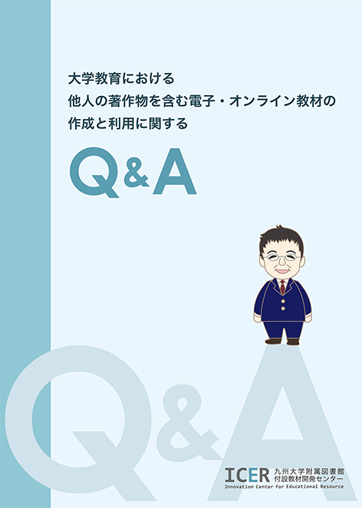

「Q & A on creation and use of electronic・online teaching materials including work of others in university education」
http://catalog.lib.kyushu-u.ac.jp/recordID/1440766
「Creation and use of electronic・online teaching materials including work of others in university education」
ICER: Innovation Center for Educational Resource
Author: Yoshida Tamifumi
Former Kyushu University Medical Research Institute Professor, cooperative teacher of ICER
Notes:
Demonstrate of license application

Slide 43
「Q & A on creation and use of electronic・online teaching materials including work of others in university education」
Can we use figures and images etc. made by others for teaching materials without permission?
What is a creative work by others?
How should we consider abroad copyrighted materials to be used as teaching materials in Japan and vice versa?
Do we need prior permission even when we use it at an educational institution such as a university?
Can we use videos published on the web in lessons?
What is the specific way to get permission from the copyright holder?
How to acquire permission when using diagrams etc. published in English journals as teaching materials?
How can we distribute teaching materials including others' creative works on the website?
Can we add to other figures and tables of creative works?
How should the source be specified?
If within the range of the citation, can you translate it and use it?
How can I handle copyright to publish recorded lectures?
Notes:
Demonstrate of license application

Slide 44
References
Case of contract between copyright holder and user
http://journals.plos.org/plosone/s/content-license
TPP，is copyright problem settled as 「non-petty offense」 or 「70 years after death」?
http://www.itmedia.co.jp/news/articles/1507/28/news071.html
Cultural Council Copyright Working Group Legislation・Basic Subcommittee (4th)
http://www.bunka.go.jp/seisaku/bunkashingikai/chosakuken/hoki/h27_04/
Call for needs to facilitate the use of copyrighted materials etc. (Agency for Cultural Affairs, Copyright Section)
http://www.bunka.go.jp/seisaku/chosakuken/needs/

Slide 45
Link related to copyright
CRIC(Copyright Research and Information Center)
  http://www.cric.or.jp/qa/hajime/hajime1.html
Lecture on copyright law on the Web
  Webhttp://copyright.watson.jp
Database of copyright case
    http://tyosaku.hanrei.jp/
  Copyright of medical image
    http://www.esite-hc.com/cn04/copyright..html

