Slide 1
Introduction to Cyber Security
― To survive in IT society ―
Social science

Slide 2
Abstract
Attack aimed at person
「Anonymity」 in information service
「Impersonation」と「Takeover」

Slide 3
Attack aimed at person

Slide 4
「Social engineering」
A method of acquiring personal secret information by trespassing incorporating into human psychological gaps and behavioral mistakes.（Wikipedia）
  Different meaning from the original 「social engineering」 (learning about the analysis and control of the organization's behavior)
  Actually may be simply called to 「social」 etc.
If we have to choose one definition, it’s analog attack
「Aimed at person」 Deception、make gaps、peeping, etc.
Because they do not use physical・technical means comparatively、it is difficult to compete them by technical means
Notes:
14:56

Slide 5
Social attacks
Spoof a fake social status and make a phone call, hear passwords and important information
Stand behind the person who operates the terminal, such as ATM, stare at the keyboard (or screen) for password for a short time、memorize that (shoulder surfing)
Memorize memos paper (sticky note etc.) of which ID and password are written.
  Often stuck around the display
Notes:
14:58

Slide 6
It’s me fraud
Phone 「It’s me、me・・・」
You 「（Who？）◯◯？」
←Information leakage：name of your friend
Phone 「Yeah、◯◯。
sorry、but there is an accident・・・」
You 「What？Your car was hit？」
←Information leakage：◯◯ is in a car
Notes:
15:00
It is quite old as a signature from around 1915?
Theater crime
As one of the features of social attacks, it can be said that information can be successfully pulled out

Slide 7
Protection of social attack
Ask them（「It’s me」「Who are you？」）
Identification
（The address had been sent to here is really right？）
Set passwords and PINs to something difficult to understand
Habit of checking if it is seeing by someone when input
Use biometrics (fingerprints, veins etc.)
Notes:
15:02

Slide 8
Time taken for password analysis of encrypted ZIP file
Word count
Only number
Lower case letter
Lower case letter, number
0 seconds
0 seconds
0 seconds
0 seconds
6 seconds
35 seconds
0 seconds
3m 6s
21m 51s
6 seconds
68 m
13 hours
1m 2s
*29 hours
*19 days
10m 50s
*92 days
*1.9 years
*100 m
*2.26 years
*67 years
（Verification environment：CPU Pentium M 1.2GHz, Memory 1GB, OS:Windows XP）
*is an estimated value calculated from the measured value
Notes:
15:04
The longer the password is the better
How longer should we set?
You can compressed zip file with password
There is software to solve the cryptography of the zip file and the total, and the average of the time taken to solve
In brute force kill it will be in this time
Limit on failure count
Two-factor authentication: Bank card and PIN etc.

Slide 9
Arrested on suspicion of Gifu prefectural officials peeking at idols' SNS with unauthorized access
Staff of Gifu Prefectural Government was arrested (violation of unlawful access prohibition law)
Unauthorized access to female idols' s SNS, peeping
Suspected that he had stolen personal information of all prefectural female staff
(Asahi news http://www.asahi.com/articles/ASJ1L0VKVJ1KULOB00V.html )
Using personal information for unauthorized access
Notes:
Well then, if it’s better of long password
Even long, but passwords using words such as those found in dictionaries are meaningless

Slide 10
Method of unauthorized access
Name：Kyuudai Tarou
Reading：Kyuudai Tarou（Kyudai Taro）
Birthday：1990 / 01 / 02
Phone Number：092-111-2222
Password：
  Name＋Birthday（Kyudai0102）
  Name＋Phone Number（taro1112222） etc.
Leaked personal
information

Slide 11
Biometrics
Using a part of your own body as 「personal characteristics」 instead of a password
  Fingerprint, vein, iris, voice
It’s different on individuals
It has a lot of information, so difficult to copy
Changes with health condition or time
Notes:
15:06
Voice changes when catch a cold
Fingerprints change with the passage of time

Slide 12
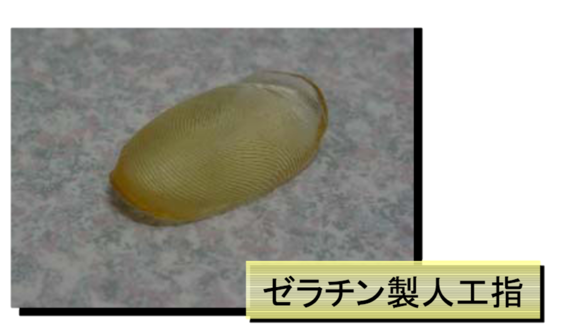
Loopholes of Biometrics？
Gelatin made
artificial fingers
（Exhibitor： FSA: Study group on fake cash card problem,
on biometric authentication in financial transactions
http://www.fsa.go.jp/singi/singi_fccsg/gaiyou/f-20050415-singi_fccsg/02.pdf ）
Notes:
15:08

Slide 13
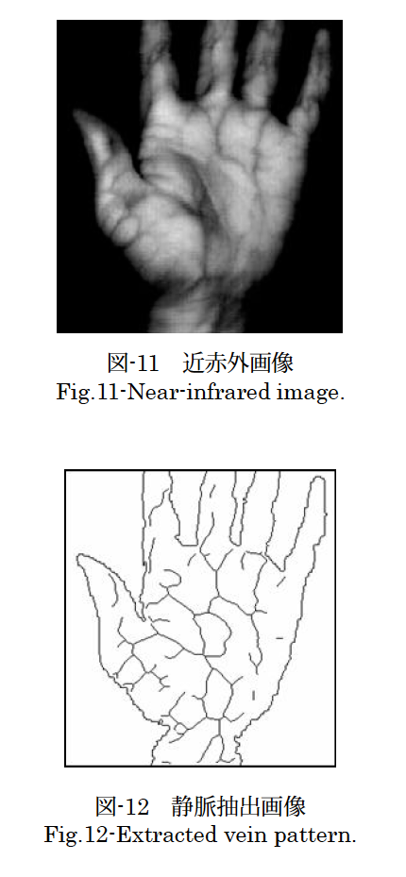
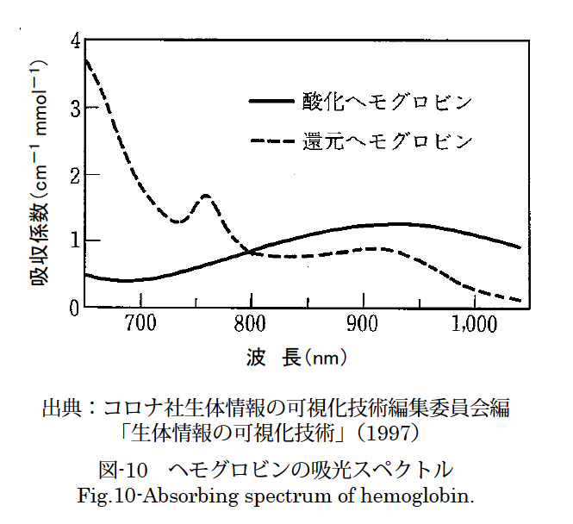
Vein authentication
Oxygenated hemoglobin
Fig-11 Near infrared image
Reduced hemoglobin
Absorption coefiicient
Wavelength
Source: Corona Company Biometric Information
Visualization Technology editorial committee ed.
Biological information visualization technology
Fig.10-Absorbing spectrum of hemoglobin
Fig-12 Extracted vein image
Notes:
15:10

Slide 14
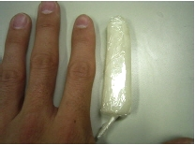
（Exhibitor： FSA: Study group on fake cash card problem,
on biometric authentication in financial transactions
http://www.fsa.go.jp/singi/singi_fccsg/gaiyou/f-20050415-singi_fccsg/02.pdf ）
Notes:
15:12

Slide 15
SNS
Distribute personal information and current status
Mutual cooperation among individuals can be concluded
Cyber community
Introducing friends from relevance
→ expanding the community
Notes:
15:14

Slide 16
General problems of SNS
Exposure of personal information
  Troubling place: Leak from yourself
It seems as if it is a closed impression, in fact it is open-minded
  Illusion that you can not see without noticing addresses
Introduction of friends
  Introduce to friends you do not want them to know
    「You wan to keep secret to B that you are friend of A」
    The system does not pay close attention to it
Ego search
  Not just your own evaluation,、how much information is exposed？
Notes:
15:16

Slide 17
Is your information really alright?
Is it OK as information is properly divided(for work, private use, hobby, etc.)?
Since information is taught only to your friends, is it okay?
It is not difficult to identify individuals if purchase information from several services,
Notes:
15:18

Slide 18
Individual identification
A
Actually I won the lottery ticket
Working at
◯◯
Like to travel
Private use
hobby
For work
SNS
SNS
SNS
User:AAA
User:AAA
User:AAA
inform
view
B
Notes:
15:20

Slide 19
Individual identification
A
Actually I won the lottery ticket
Working at
◯◯
Like to travel
Private use
For work
Hobbies
User:AAC
SNS
SNS
User:AAB
SNS
User:AAA
Picture taken place
(GPS information)
Date and time
Inform
view
Pictures
Same pictures
as for hobbies
Travel
pictures
Image searching
Close
Same pictures・・・
B
holiday and itinerary matchs
Notes:
15:22

Slide 20
Identification of personal information
Primary school student who is not yet net literacy posts his real name and address
Identify the location from the photo’s Exif
Share same photo with acquaintance
Identify one person from identical IDs of multiple services, identify Facebook from Yahoo auction account
Notes:
15:24

Slide 21
Extract information from personality diagnosis?
Character diagnosis by answering various questions
Is it possible to answer questions that are not normally answered by being tired for questions？
  Like、dislike、feeling etc.
    General questions
  「Behavior」 or 「experience」 etc.
    Information tied specifically to an person
As you answer the questions、you will be identified
Notes:
15:26

Slide 22
Zushi stalker murder case
Search a lover broken long ago online
Full use of question site (Yahoo Chiebukuro) etc
Appear as acquaintance, listen to people nearby
「It’s a question to who living in＊＊＊。I’m looking for a person who took care of me in the past。It’s seems she is living in＊＊＊、but don’t know a detailed address」 question like this etc.
Notes:
15:28

Slide 23
Bit coin
Peer to Peer type payment network and encryption currency based on open source protocol using public transaction log.(Wikipedia)
A type of electronic money
Managed in non-centralized manner（Mutual monitoring by P2P）
Specially considered security
Monetary value is not stable
Notes:
15:30

Slide 24
P2P Network
Bit coin
Even if one part is bad,
the influence on the whole is less
Notes:
15:32

Slide 25
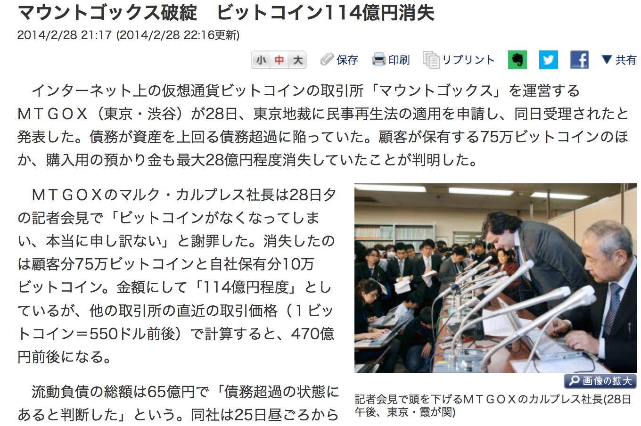
Is bit coin dangerous?
Failure of Mount gox, 11.4 billion yen disappeared
2014/2/28 21:17 (updated at 2014/2/28 22:16)
MTGOX, which operates an exchanges "Big Coin" exchange on the Internet, applied for
civil rehabilitation law on Tokyo District Court on 28th, announced that it was accepted
the same day. Debt exceeded the asset was defined as exceeding the debt. In addition to
the 750,000-bit coin held by the customer, it was found that the deposit for
purchase was also disappeared up to about 2.8 billion yen
MTGOX president Mark Marcubrez apologized at the press conference on the evening of 28th, "I am sorry that bit coins are gone."
The loss is about 750,000 bit coins for customers and 100,000 bit coin owned by the company, which is about 11.4 billion yen in amount, but if calculated with the most recent transaction price (1 bit coin = 550us dollar) of other exchanges , It will be around 47 billion yen
The total amount of current liabilities was 6.5 billion yen [determined to be in the state of excessive debt], the company said from around noon on the 25th
MTGOX president Calvres who headed down at
a press conference (28th Afternoon, Tokyo, Kasumigaseki)
（Nihon keizai news 2014/2/28）
Notes:
15:34

Slide 26
P2P Network
Bit coin
user
Exchanges
A
Bit coin
yen
Notes:
15:36

Slide 27
Crackers aimed at the system of the bit coin exchange, and the bit coin was stolen
The bank vault was attacked and the cash was stolen
Notes:
15:38

Slide 28
Problem of Information diffusion
Information diffusion on the net is fast, once it spreads it is difficult to erase
  Digital Tattoo
    From 「Can not be extinguished」、to 「Someday」
Once information is flowed along the acquaintance relationship with SNS, damage is great
  Revenge porno
If it is distributed and recorded like a P2P network, it is impossible to trace where the information remains
To hear personal information by calling mass media or net questionnaire
Notes:
15:40

Slide 29
Digital copy
Copy chain
In the past (analog), every time you copy it, it deteriorates and it will naturally disappear.
  Because it is a digital copy now, it is difficult to annihilate naturally
  Cloud service or P2P
  We do not know where it will be stored, so we can not erase it
Once it flows、be prepared that it can not be erased any more
Notes:
15:42

Slide 30
Case) 2ch
Posted personal information on 2ch
Delete request from himself
Had been copied to summary site
So we don’t know how many copied were made
Even if it disappears from 2ch, it’s practically impossible to erase from all copy sites
Notes:
15:44

Slide 31
Chain mail
A letter requesting to distribute to an unspecified majority in a chain（Wikipedia）
  Classical：「Letter of unhappiness」 or 「Letter of happiness」
    Person who received this letter must send it to 10 people within 24hours・・・
  Post before
  Become e-mail since age of net
    It’s possible to involve a lot in a short time
  Besides mischief and pleasure, as a means to attack information system
Because it comes from an acquaintance, I trust unconditionally
Do not be scared by information
  Measure：Thoroughly confirm source of information
Notes:
15:46

Slide 32
Various chain mail
Attachment trouble of Saga Bank
On December 25, 2003, chain mail called "Saga Bank collapsed on December 26" circulated, attachment trouble occurred, Saga Prefecture Police detained transmitted woman for criminal charges.
Successive TV program impersonation From around 1999, a series of chain mails spoofed as 「The Tetsuwa! DASH !! (Nippon Television)」.
Teddy Bear virus
「jdbgmgr.exe（Icon is teddy bear）is a virus, delete it!」 In fact, this exe file was an authorized system program for debugging JAVA、but many people believed that and deleted program、Information Processing Promotion Agency Association called for attention。
Chain Mail on 2011 Tohoku Region Pacific Offshore Earthquake 「Since the harmful substance diffuses due to the explosion of the Cosmo Oil Chiba Refinery, it falls together with rain and others, so as not to expose the skin」 diffuses. Typical of piggybacking chain mail.
Notes:
15:48

Slide 33
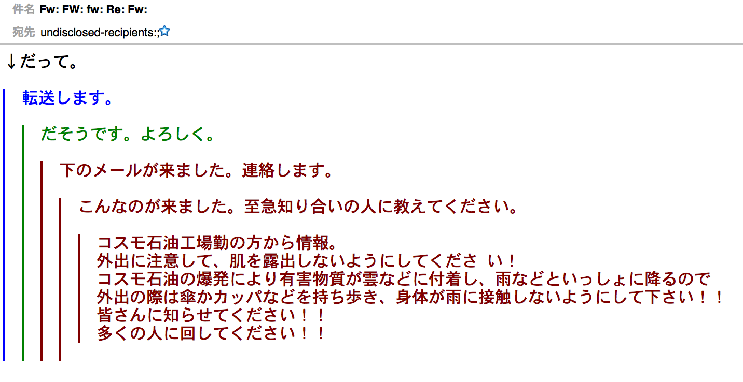
「Degradation of quality」
Digital data does not degrade
By repeating the transfer, the quality of the data deteriorates
  By route and medium
  （Ex） E-mail transfer and Twitter's Retweet etc.
because
Transfer it
It seems be, please
This mail came, contact you
Received this mail, tell your friend immediately!
Information from people working for Cosmo Oil Factory
Please be careful not to go out and avoid skin leakage!
Because the harmful part sticks to clouds etc. due to the explosion of Cosmo Oil and it falls with rain etc.When going out, please carry an umbrella or kappa, etc. so that your body does not touch the rain!
Please let others know!!!
Please pass it to many people!!!
Notes:
15:50

Slide 34

Scary place of chain mail
Believe it because it’s been send from your acquaintance
send
transfer
transfer・・・
Unauthorized
sender
Mr. A
Mr. Ｂ
It’s okay because it from A
Notes:
15:52

Slide 35
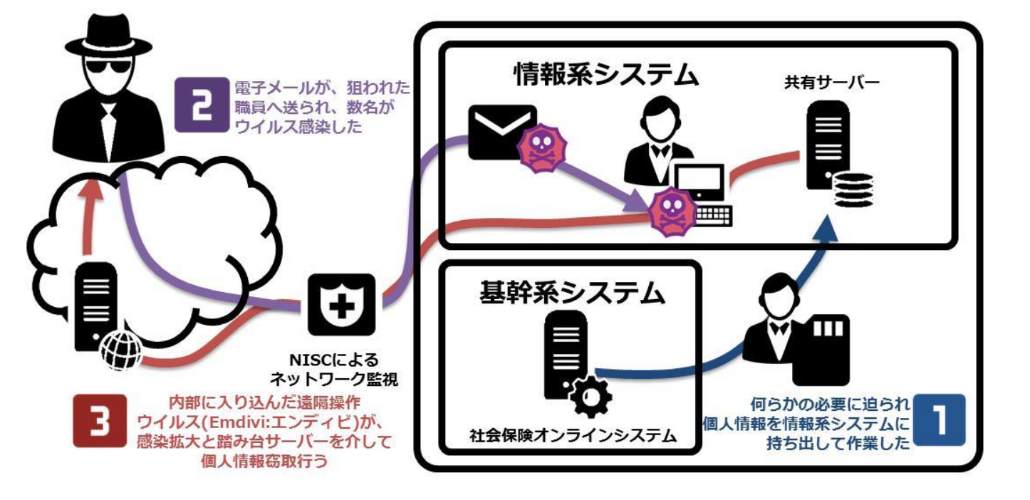
Recent case: Targeted e-mail (Information leakage by the pension mechanism)
E-mail had been sent to target officials, several were infected with virus
Information system
Shared server
Enterprise system
Net surveillance by NISC
was forced to do something, and brought personal information to information system
The remotely-controlled virus (emidivi) stolen personal information via infection spread and stepping server
Social insurance online system
From Rack Co., Ltd’s public material.
Notes:
15:54

Slide 36
Recent case：targeted e-mail
Mail with malware in chain mail format
Zero-day attack, citation from the academic society HP
malware
send
transfer
transfer・・・
Unauthorized sender
△△ University
□□ University
We are ◯○ conference
transfer it to the academic society.
It’s okay from △△ university
Notes:
15:56

Slide 37
Dealing with targeted e-mail
Chain mail （Wonder receiver to transfer it）
  Do not transfer
Trojan horse （Dangerous attachments）
  Do not click attachments
Fake address （Link in mail）
  Confirm address
  Something similar is impossible
Fake document （suspicious content)
  Depending on the content, confirm with sender
  If possible, confirm by another route such as telephone
Notes:
15:58

Slide 38
Privacy and identity
Privacy
Private and private life in individuals and families. The secret of the individual. Also, it is the right not to receive interference or infringement from others.
Identity
１ Self as being continuous and identical, regardless of environmental and time changes. Independence. Self identity. 「The loss of -」
２ Do not mistake himself. Also, identification.
（Daikei）
Notes:
16:00

Slide 39
When using a specific service, it is necessary to provide personal information → risk of leakage
Online settlement: credit card number → risk of card number leakage
Application usage：Behavior history →Tracktion of action pattern
Online shop：History of purchase →Promote similar products
Notes:
16:02

Slide 40
My Number
Every person having a resident card one by one, is used to manage information efficiently in the field of social security, tax and disaster countermeasures, and to confirm that information on individuals existing in multiple institutions is the same person's information.
（Cabinet Secretariat HP Mina's My Number Description
http://www.cas.go.jp/jp/seisaku/bangoseido/gaiyou.html）
Notes:
16:04

Slide 41
Identification of an individual
A
Actually I won the lottery ticket
Working at
◯◯
Like travel
For work
hobbies
Private user
SNS
SNS
SNS
User:AAA
User:AAA
User:AAA
inform
view
B
Notes:
16:06

Slide 42
My Number
A
merit
Prove to be yourself,
Simplify procedures for
multiple tasks
Working at
◯◯
savings
For work
tax
bank
workplace
Government office
User:AAA
User:AAA
mynumber
mynumber
mynumber
User:AAA
inform
view
demerit
It is easy to identify
individuals
As a result,
it tends to lead to
infringement of privacy
B
Notes:
16:08

Slide 43
Summary
Although it is cyber space, there are still few analog attacks
  It is also possible that analog attacks are done through the net
Publish personal information carefully in SNS etc.
  It is difficult to delete information that once flowed
Do not be scared by information。
  Confirm source, if possible, by another route
Merits and demerits of providing personal information
Notes:
16:10

Slide 44
Today’s content
On the problem of human nature that can not be solved by information technology / difficult to solve
  Privacy and anonymity
  Impersonation and takeovers
  Exploitation of social features of SNS
  And so on…
Notes:
Since it was gathered up in last lecture, this time there are no miscellaneous contents

Slide 45
「Anonymity」 in information service

Slide 46
Services on the internet
Various services are provided on the Internet
  Services for users receive information
    Various official website of companies and organizations
    News site
    Information site・Search site…
  Service for users to transmit・exchange information
    E-mail
    Bulletin board system（BBS）
    Blog・Chat
    Question site…
Notes:
Today, we mainly focus on serves that send and receive information by especially unspecified users

Slide 47
Conversation・Exchange using Internet
E-mail
  PC、telephone、smartphone
  Gmail、Yahoo! mail ...
Bulletin board system（BBS）
SNS（Social network system）
  Facebook、Twitter、mixi ...
Chat・call
  LINE、Skype ...
Notes:
There are various kinds of information exchange mechanism using the net
In the old days, from e-mails and bulletin boards to more sophisticated SNS, even to audio、image and video in real time interchangeable
Some use it with acquaintances you've met before, others like to use with someone you do not know at all

Slide 48
「Anonymity」 in information service
A state hiding your own 「real name」
  Privacy protection and coinage
    Keep private things such as private life and hobbies secret
    You can also disclose by your own intention
  (Relatively) not required for social responsibility associated with real name
    Can act and speak freely without being restricted by social position, title
    「A certain level of」 Reliability
Actually do not know what is written by who
  Even in the case of 「self-introduction」, you do not know the authenticity of the contents
Notes:
This depends on the service you are using,
But you should particularly feel that when you reading or writing on bulletin boards that do not require user registration
Just watching the screen you normally use does not know who the message was written

Slide 49
Net and 「Principle」
In many exchange sites etc., personally identifiable information is not disclosed
  Sometimes there are also necessary for registration of service use
Individuals are distinguished by user name, nickname, etc.
  Write in writing and action
  Sometimes there is also 「profile」 page for registration system
    However it’s unknown whether they write truth
  Many sites only need to register mail address
There are also sites require real name like the facebook
  Some people also may be register with pseudonym
Notes:
Although the example here is not a registration system, even if it is possible to register the profile of the user by registration system,
It is not always that users write their real things, so it is not easy for users to know each others

Slide 50
Misuse of 「anonymity」
For services that do not require registration of personal information
「Since you are anonymous, you can do any thing and do not worry about being identified. 」
Think like this and do malicious behavior（misuse）
  Impersonate as another person on bulletin board
  Pretend to be a famous person on Twitter
  Slander, exposure secret, others
Notes:
Then, some people may think that they will do mischief or bad things
Actually there are people who do such things
If it is a petty mischief, maybe you will not be directly blamed (though complaints will come through the net)
But when you escalate, you sometimes do something that touches the law.
So do you think you can not be found in that situation?

Slide 51
Anonymous illusion ／ Anonymity is an illusion
For services that do not require registration of personal information
「Since you are anonymous, you can do any thing and do not worry about being identified. 」
this is not a fact
In most cases it’s possible to specify
  It takes labor and time
  Authority required (administratively or related to management responsibility)
Notes:
In fact it’s not
Some people may have seen and heard from news as they talk about it sometimes,
about some people are arrested for notice of crime at the bulletin board
Here explain little technical explanation about why they can be found

Slide 52
Structure of Network service
Term
  Client
    It’s indicate a terminal（personal computer or smartphone）、or a software・application that receive service
  Server
    It refers to the system that provides service, or software running on it
Service using the network,
is realized by 「Client communicates with server」
Notes:
Including not only viewing the web on a personal computer but also using the application on a smartphone,
many of the services that use the network
Is information’s exchanges between server on the service provider side and client

Slide 53
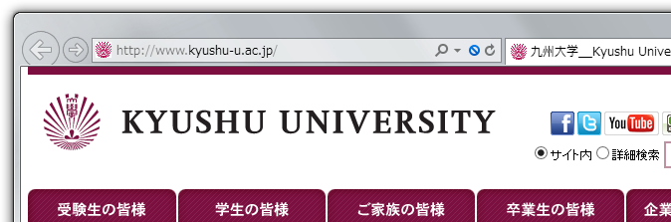
「Server」 and 「Client」
HTTP/1.1 200 OK
Date: ...
Internet
GET / HTTP/1.1
Server
www.kyushu-u.ac.jp
Client
(Actually, even if only 1 page is printed, messages are exchanged tens of times)
Notes:
Consider the case where the client is your computer and you see the official page of Kyushu University there
It is omitted here how to find the server on the official page of Kyushu University
In this example, we send the data of the top page of Kyushu University from the client to the server, and received the contents as a response
In fact, the same processing is done for each image included in the page, and the top page can be displayed as a result of data being exchanged tens of times
here is no need to remember this "GET"

Slide 54
「Internet」
Computer network communicate based on the agreement「Internet・Protocol
  Computers and smartphones etc. all communicate using 「Internet・Protocol」
Can not communicate if break the agreement
  The communication partner can be traced based on the mechanism
Notes:
We said that the client and the server are communicating, but need agreement in order to communicate
Communication agreement at "Internet" that we use everyday are decided to be called "Internet Protocol”
The network of the computer communicating with is called Internet
Since you can not communicate without following the agreement,
you can trace the communication partner if you use a rule that is decided according to the structure

Slide 55
IP Address
All machines connected to the Internet have a number 「IP address」
  Four numbers between0～255 （For IP version 4）
    「133.5.1.1」 etc.
    About 4 billion rough combinations
      Not enough！→ IP version 6 （Incompatible）
  The communication partner can know the IP address of the communication source
    The service side generally records the connection date and time
  Personal computers and smartphones are often allocated automatically
    It not change while communicating at least
Notes:
So, in order to communicate over the Internet, things like the address "IP address" are absolutely necessary
Also it’s attached to everyone's computer and smartphone
And when communicating with the client and server etc, the address of the other party is notified (you can not get a reply if you don’t do this)
The server usually records all things like the IP address of the client and the date and time of communication
The fact that client’s number is actually means, it can be narrowed down in many cases depending on how it’s used
However, in many cases it is not easy

Slide 56
Webサーバのログ（一例）
133.5.11.11 - - [19/Jul/2016:12:17:52 +0900] "GET /roundcube/ HTTP/1.1" 200 4070 "https://mail.m.kyushu-u.ac.jp/" "Mozilla/5.0 (X11; Linux x86_64) AppleWebKit/537.36 (KHTML, like Gecko) Chrome/38.0.2125.102 Safari/537.36"
133.5.11.12 - - [19/Jul/2016:12:42:05 +0900] "GET /roundcube/ HTTP/1.1" 200 4072 "https://mail.m.kyushu-u.ac.jp/" "Mozilla/5.0 (Macintosh; Intel Mac OS X 10_9_5) AppleWebKit/601.6.17 (KHTML, like Gecko) Version/9.1.1 Safari/537.86.6"
133.5.11.10 - - [19/Jul/2016:12:47:11 +0900] "GET /roundcube/ HTTP/1.1" 200 4072 "-" "Mozilla/5.0 (Macintosh; Intel Mac OS X 10_10_5) AppleWebKit/601.6.17 (KHTML, like Gecko)"
133.5.11.10 - - [19/Jul/2016:12:47:11 +0900] "GET /roundcube/ HTTP/1.1" 200 4071 "-" "Mozilla/5.0 (iPhone; CPU iPhone OS 9_3 like Mac OS X) AppleWebKit/601.1.46 (KHTML, like Gecko) Version/9.0 Mobile/13E188a Safari/601.1"
133.5.11.12 - - [19/Jul/2016:13:01:29 +0900] "GET /roundcube/ HTTP/1.1" 200 7970 "https://mail.m.kyushu-u.ac.jp/" "Mozilla/5.0 (Macintosh; Intel Mac OS X 10_9_4) AppleWebKit/537.77.4 (KHTML, like Gecko) Version/7.0.5 Safari/537.77.4"
133.5.11.10 - - [19/Jul/2016:13:14:50 +0900] "GET /roundcube/ HTTP/1.1" 200 4070 "https://mail.m.kyushu-u.ac.jp/" "Mozilla/5.0 (Windows NT 10.0; Win64; x64) AppleWebKit/537.36 (KHTML, like Gecko) Chrome/46.0.2486.0 Safari/537.36 Edge/13.10586"

Slide 57
Webサーバのログ（一例）
133.5.11.11 - - [19/Jul/2016:12:17:52 +0900] "GET /roundcube/ HTTP/1.1" 200 4070 "https://mail.m.kyushu-u.ac.jp/" "Mozilla/5.0 (X11; Linux x86_64) AppleWebKit/537.36 (KHTML, like Gecko) Chrome/38.0.2125.102 Safari/537.36"
133.5.11.12 - - [19/Jul/2016:12:42:05 +0900] "GET /roundcube/ HTTP/1.1" 200 4072 "https://mail.m.kyushu-u.ac.jp/" "Mozilla/5.0 (Macintosh; Intel Mac OS X 10_9_5) AppleWebKit/601.6.17 (KHTML, like Gecko) Version/9.1.1 Safari/537.86.6"

Slide 58
From home (example)
The server administrator can know the IP address of the connection source
  Which provider provide this address can be investigated
The provider usually knows which customer is assigned to this address
  After compare it with customer information, you can know who is there
Not everyone can see these information
  When there is an investigate warrant or a court order
  Normally is private from the viewpoint of privacy and personal information protection
Notes:
Ignoring personal information protection or legal aspects, I will talk about technically
For example, a network of NTT, BBIQ or cable television came at your home, let's say you are using the net from there
Since the server administrator records the IP address of the client, it knows the IP address of the client that did something bad
Once you know the IP address, there is a mechanism to find out what organization has the address
For example, J: COM
J: COM knows how it is used in J: COM, but that administrator of the company can investigate that.
Cable TV distributes a cable modem and you can see which machines are where and which addresses are allocated
By looking up customer information you will know both the address and the contact information
Whether or not you can actually provide that information is another matter, for example, an individual will not tell you even if you listen directly

Slide 59
What is Kyushu University?
Kyushu university itself is provider
  Allocate IP address to department to provide connection
Student ID and SSO-KID are required to use kitenet and edunet
When and which ID and which number had been recorded
  Investigation is possible if complaints or notifications are received from the outside
Actual cases of copyright infringement and inconvenience cases are exist
  They will be called when malicious
Notes:
The same for Kyushu University,
We can know immediately that the IP address starting with 133.5 is from Kyushu Univ.
From A to B, is ISEE, because it’s be allocated to that
Then contact the department, the department will investigate
In the case of Kitenet and edunet, it is necessary to input the student ID and SSO - KID,
It’s easy to know when and who using the address, so they can contact the principal directly,

Slide 60
Tracking is not perfect
Even you know the terminal with that IP address, but who was using it at that time?
That’s conversely avoidable if you knowing the mechanism of IP
  Ex：「Remotely operated virus」 incident
    Conceal communication source via multiple steps
    If you practice carefully, you can even deceive experts
Actually for general public there is normally not disclosed information
  If you know 「only」 IP address, you don’t know real address
Notes:
However, tracking like this can not always be done, sometimes it gets cut off in the middle
In recently talked-about remote controlled virus incidents, various mechanisms were used to make tracking difficult
Especially overseas, there are also non-cooperative providers for pursuit and it is becoming a hotbed of crime
The provider may know who assigned the IP address, but it is not disclosed to the general public
So, no one know where user lives even if only IP addresses are born
(Although it is likely to be used in one-click fraud etc. by displaying the IP address to threat someone, it is normally OK)

Slide 61
Identification from other information
Uploaded photos
  Position information acquired by GPS etc. may be embedded
  Hobbyists to identify places from background etc.
  Development of image search service
  Development of facial recognition service
Search for write history
  Collect surrounding information from past writes
There are people who like to 「Identify」
Notes:
We talked about tracking from the technical mechanism of the Internet, but there are many other factors that will identify individuals
For example, when photographs are taken with machines capable of acquiring position information such as smartphones,
position information may be embedded in the pictures
If you are a somewhat familiar person, you can find out exactly where the picture was taken by investigating it
There are also people who like to investigate someone's photos of strange posts and others, so should be careful of posting photos
Things like analogizing places often going from past posts are often done

Slide 62
Same in reality and net
Do not act nuisance or illegal acts in real society or on the net
  Do not write criminal acts or similar things
    Criminal acts are caught as police investigate
    People who try to identify 「flames」 will come
  Conscious of contents of writing and disclosure range
    Also be careful even your friends’ intention
    「There is nobody seeing people like us」 is wron
    Do not write information that can identify individuals such as address and telephone number
Notes:
If you submit things like drunk driving or speeding violation, it tends to be terrible, stop it.
If you think no one will know that, you make a big mistake

Slide 63
「Thief at a fire」
When disaster strikes, more attacks・fraud occurred which piggy-backed on disaster
  Contents about disaster · Fishing mail · Tweet related to disaster
  Fraud of personal information multiplied on confirmation of safety
  Many hoaxes
IPA「Analysis・survey report on cyber attack of targeted attack mail multiplied on the Great East Japan Earthquake」
  https://www.ipa.go.jp/about/shinsai/security.html

Slide 64
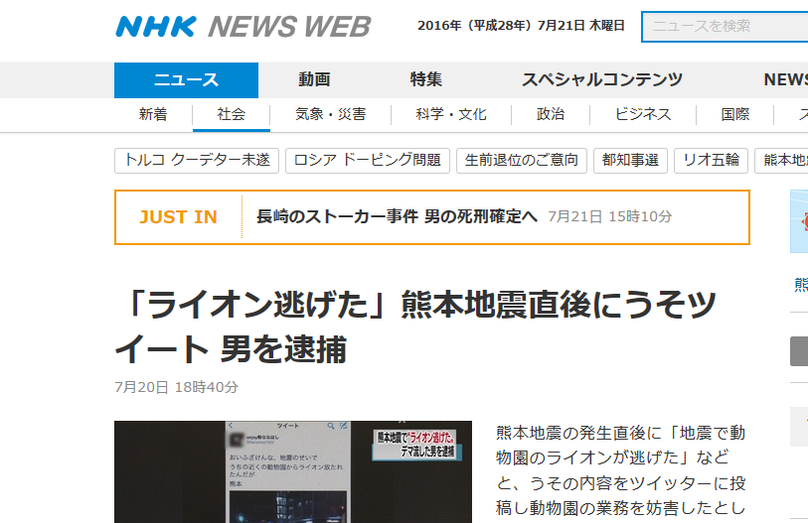
Even a malicious hoax is arrested
2016, 7/21 Thursday
news
animation
feature
Special contents
New
Society
weather.
disaster
Science.culture
Politics
Business
International
Stalker event of nagasaki, convinced death penalty for that man
『Lion ran away』 Arrest a man lied on twitter
after the Kumamoto earthquake
7/20 18:40
Just after the Kumamoto earthquake,
posted the content of lie message 「The Zoo's Lion
escaped with an earthquake,」 to Twitter and interfered with the operation of the zoo
http://www3.nhk.or.jp/news/html/20160720/k10010602351000.html
http://www.huffingtonpost.jp/2016/07/20/lion-escape_n_11081056.html

Slide 65
Retweet・share
59% of those who retweet without confirming original articles on Twitter (research in the United States and France)
  Satisfying by spreading only looking at titles and summaries
  https://www.washingtonpost.com/news/the-intersect/wp/2016/06/16/six-in-10-of-you-will-share-this-link-without-reading-it-according-to-a-new-and-depressing-study/
The topic of catchy title is easy to spread (even if there are lies and mistakes)
  Even if there is a correction article it will not diffuse enough to catch up
Notes:
Inadvertent spreading of information can be irrevocable

Slide 66
「Impersonation」 and 「Takeover」
Notes:
The story changes from here
Although it was a story that person can be identified, from here it may be a bit confusing because it is e a reverse story
However, what can be specified is the story of administrators’ cooperation ,
for the person who normally uses it, it is still difficult to know others on the other side

Slide 67
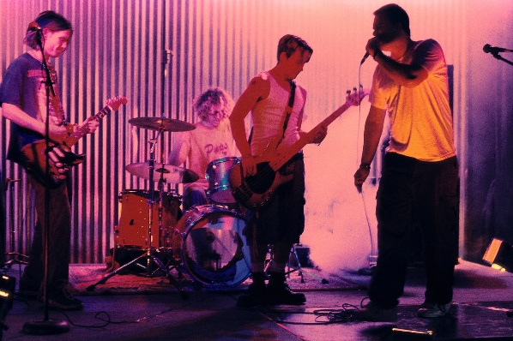
「Impersonation」
I saw write by celebrities and famous organization names on bulletin boards and SNS!
Have you ever doubted whether it is really by genuine thing?
Notes:
There are people who misuse 「hard to understand」 to 「impersonation」
When you find a name of a famous person as a fan, the tension tends to rise and the judgment power tends to become dull
But should feel doubt about whether this is real in a corner of head

Slide 68
Example of Twitter
A few years ago, A ID appealing Kyushu University official account appeared
  Cancellation information etc. tweeted(Currently disappeared)
Fake ID of entertainers and well-known companies
  Use ID names and profiles reminiscent of the real thing
  In the case of a bot(an account that repeats their past remarks automatically)
Notes:
As recently you can quickly make a fake account of Fufunshi's younger brother

Slide 69
Measures
Confirm whether it’s published in other official information(homepage etc.)
Sometimes even a lot of followers are fakes
  That’s just many people were deceived
「Trusted account」 (supposed) to be reliable
  Only people who Twitter approved can get
Report to management if self-impersonated

Slide 70
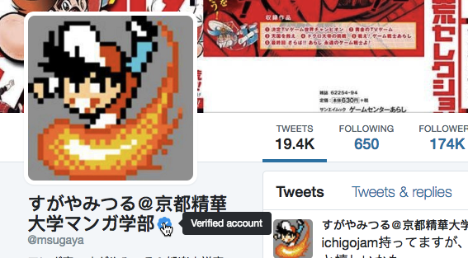
Verified Account A
Tweets
19129
Follow
629
sugamiyatsuru@
Kyoto Seika University
manga department
Verified account

Slide 71
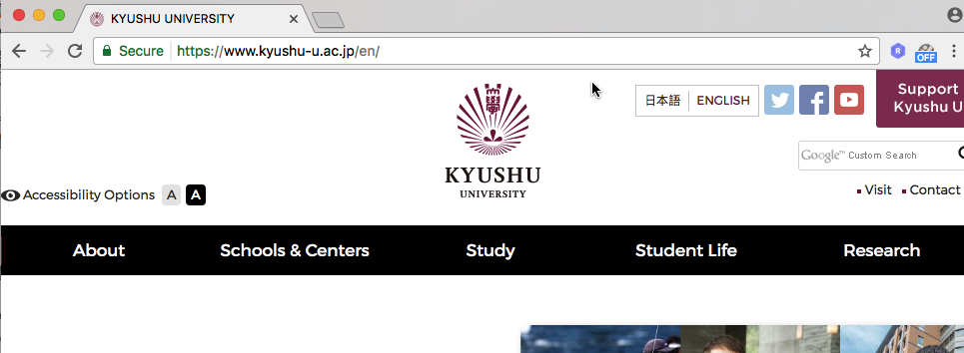
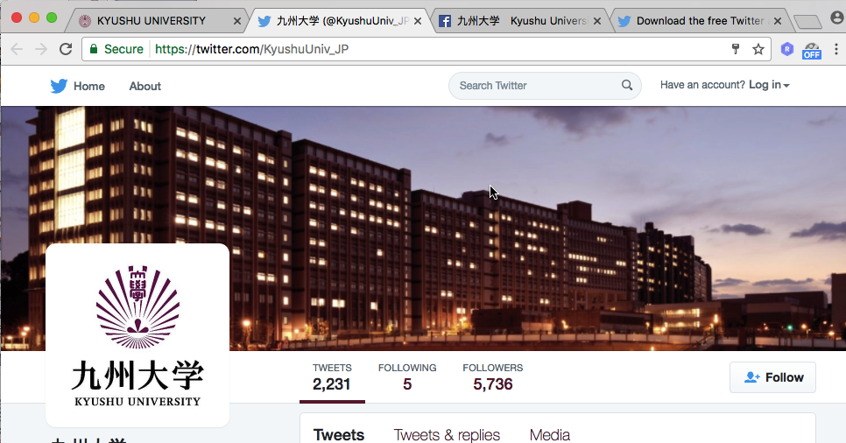
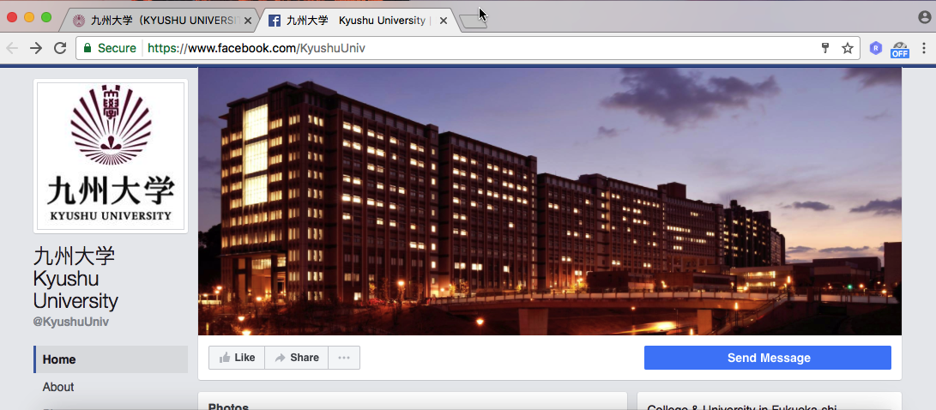
Kyushu University Official Account
Notes:
In Kyushu University, an organization called PR department has official accounts on Facebook and Twitter
Link to official account from official page to show that it is genuine
If you just search on the search page, you may get caught by a fake account with the same name
Be sure to make a habit of matching with other sources

Slide 72
「Take over」
Account is protected by 「ID」 and 「Password」
  People who know ID and password can use that account
  What if the information leaks to another person (malicious)?
Fraud by e-mail account hijacking
  「I am troubled with the theft at the travel destination, please send me some money」
Fraud by hijacking LINE’s ID
  Pretend to friend and let you buy something like webmoney, and let you give them photo of charging code
Notes:
Although it was "impersonation" that another account deceives celebrities and the like,
the fact that the real person's account is being "taken over" by another person also remains
Though it is thought that it is understood by the person actually using, if you use Twitter etc., it should have registered account and set ID and password
Only those who know the two strings can use that "account". An account is a usage right of a service
Since the service provider thinks that the person who knows the character string is the person himself / herself,
if the character string leaks and it is used by another person, it will be taken over
For Twitter, official accounts start to tweet something strange or spreading viruses is huge
Sometimes a friend's email account is taken and a fraudulent mail comes. I have personally got such an e-mail.
After all that person had no choice but to discard the e-mail address and past e-mails
Also, cases of LINE's ID being hijacked around this spring and tricking off money were frequent

Slide 73
Actually sent fake mail
Subject: Loan
Kindly pardon my ignorance for not informing you about my urgent trip to spain and for reaching out to you this way. I'm seriously in mess over here and I need you to help me out. I thought it expedient for me to confide in you and I will be glad to have this confidential between us. I was a victim of harm robbers here. Though I wasn't hurt, I'm mentally and physically ok, but my money, mobile phone and my bags with some vital documents were taken
away by these guys. I'm urgently in need of some money to complete my major aim of being here and to balance my bills till my departure next weekend.
（Continue）
I had urgently come to Spain, but a thief stole my bag containing cash, phone and important documents.
Cash is urgently needed to finish my errand.

Slide 74
Actually sent fake mail
Can you please lend me a sum of 2500euros [approximately $3300 us dollars] or any amount you can afford to lend me? I will refund you back upon my arrival back home. if you would be able to help me out with the money or any amount you can afford, below is my name and the require details for you to make the transfer on my name at any western union money transfer outlet/office.
Name: （Name blank）
Address: （Address blank） 08011 Barcelona
Country : Spain
I don't yet have a local phone (still gathering my bearings and such), so email is probably the best form of contact for now. I will expect your response soon.
Thanks & Regards.
--
（Name blank）
I will return it when I return country,
Can you immediately remit 2,500 euros (about 3,300 dollars) to the address below, I do not have a phone yet so please contact me by e-mail.

Slide 75
victim becomes a perpetrator
Your ID is taken over and impersonated
↓
Damage to friends・family who trust yourself
It’s same to 「It’s me fraud」
  Even you do not think you have important information、your human relations itself can be misused
Notes:
Some people think that it is not a big deal even if they are taken over because their information is not a big deal
In fact, your acquaintance suffered damage and inconvenience
human relations itself is useful information, and the fraud which uses it is increasing very much
Same as It’s fraud
You need to be careful not be deceived when others are taken over

Slide 76
Measure for takeover
Do not be taken over
  Proper protection of user name and password
  Antivirus
  Do not lend personal computers or smartphones to people who do not know
  Do not get caught when acquaintance is taken over
  Even if it is said to be urgent, do not be panic
  contact the principal by other ways
  Check with other acquaintances in common

Slide 77
Cooperative application・site
There are lots of applications and sites cooperate with Twitter and Facebook’s information
  Services that can 「Log in with Twitter」 instead of making individual accounts
    As a user, you do not need to create an account individually
    service providers can use a major strong authentication base, it is safe
  Service using SNS information
    Cooperate・Fight in game with friends of SNS
    Analyze your remarks
    Send message card to friend, etc…

Slide 78
Collaboration and information provision
Ex: If you use 「Login with Facebook」
  Jump to Facebook’s authentication(login) page
    Confirm that the URL is Facebook
  When you log in to Facebook, you will be asked for information or permission to provide
    In most cases basic information (name or email address)
    Your friends' information and posts depending on services
    Authority to post on behalf of me
  do not know Facebook’s password
    Only transmit that log in succeed

Slide 79
Always check cooperative app
There is also a malicious application・site
  If you give inadvertent posting authority, it’s same to be hijacked
Be care of 「Diagnostic system」
  Acquiring posts to making a diagnosis, etc.
    Browsed personal information may also be diverted
Do not cooperate with a unknown site
  Even if it flows from a friend, there is a possibility that your friend is also caught

Slide 80
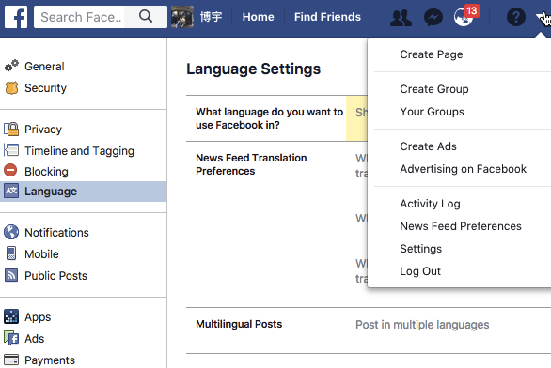
Facebook （Settings→App）

Slide 81
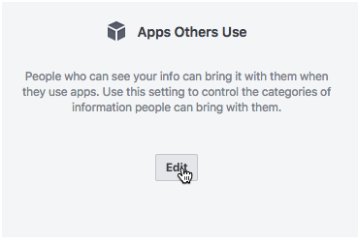
Apps other Use

Slide 82
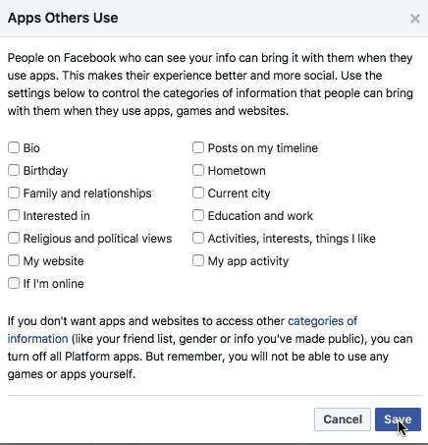
Do not know public what

Slide 83
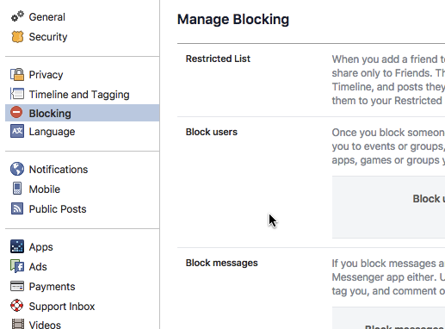
Block suspicious things

Slide 84
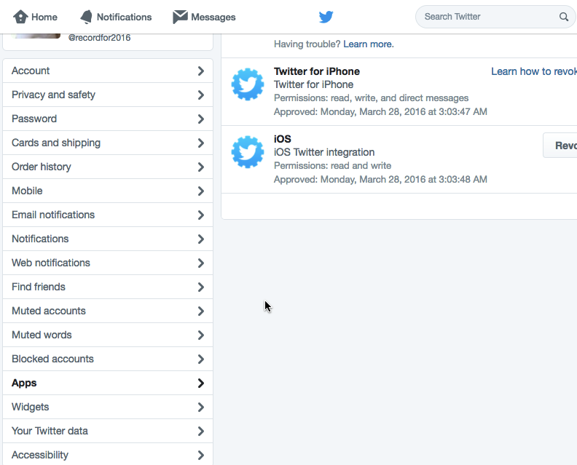
Twitter （Settings→Apps）

Slide 85
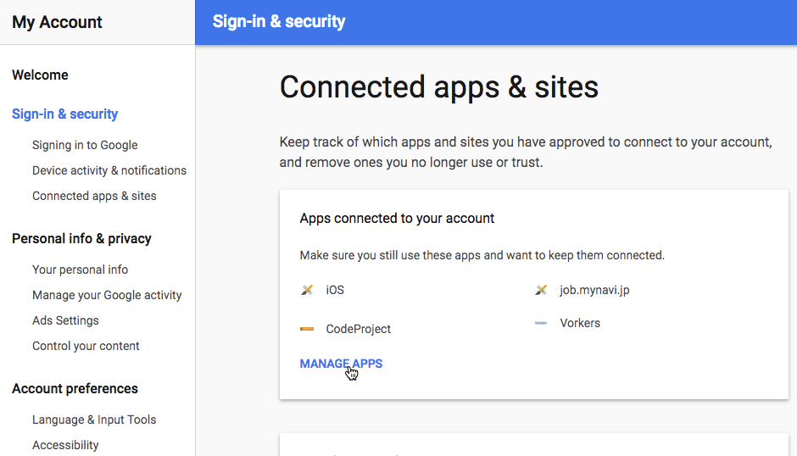
Google（接続済みのアプリとサイト）

Slide 86
Personalization and filter bubble

Slide 87
Filter、Filtering
Tools and functions that sort out (distinguish) target under certain conditions
  Selectively block all communication for certain target
  Do not transmit information to target you don’t want them know
    「Privacy filter」 etc. so that others can not see your smartphone screen
For each organization operated on the network, applied standard are different
  Filtering for protecting young people(from harmful information)
  Regulation according to network operation purpose
  Prohibit access to security-dangerous Web sites
  Regulation・Control by country
Basically、it’s done under unified・explicit standards and policies

Slide 88
Recommend、Recommendation
Recommendation
  Recommendation service in online service
  Collect large volumes of user‘s behavior data (search・browse, purchase history etc.), predict information relating to current situation of a user from past actions and similar user information、preferential present to user
    「People who bought this product also bought such items」「recommended」（shop site）
    「recommended users」「maybe friends」（From SNS、human’s relationship data）
Personalization
  Accumulate usage history of personal service and other information、base on those data、to create an 「easy to use」 environment matches user
  Search results

Slide 89
Filter bubble
「Recommendation」 base on behavior history 、give biased information by personalization
  Priority give that person information he want, likes, wonder to click
  If you depend on services on the net, available information will become bias, you can only see those who think and behave similar to yourself
  Contradictory to net’s advantages of knowing various people and acquiring wide new knowledge
Image of wrapped by transparent bubbles ＝ 「bubble」
  Do you get trapped in 「filter」 before you notice?
A person named Eli · Pariser advocated (2011)
  The video is released by TED (also on Youtube)
  Search by 「closed Internet」, 「filter bubble」, etc.

Slide 90
What is the problem？
Information that is the basis of action is biased＝Can not 「Decide by yourself」
  A system that you do not know well, determines the range of your actions
  You do not know about that
Among the people of same opinion・position、assertion becomes increasingly extreme
Can not see the presence of people in different positions
  It’s difficult to objectively judge and grasp reality
  Domestic、foreign elections ,etc. → 「Unexpected result」
  A similar bias is also applied to mass media such as newspapers and television･･･
  It is easy to watch out because a lot of people are watching and talking about it
Leading to narrow vision, indifference

Slide 91
What should we do?
One way of avoiding personalization (logging out at the time of searching etc.)
  Reset、 erase history information etc.
Use multiple services differently, not depend on one service
Do not use cooperating services
  User's information is shared, can be used for more powerful recommendations

